Slide 1
Mankind at the Turning Point
Mihajlo Mesarovic &Eduard Pestel
Tapio Kanninen
40th Anniversary Celebration
Scandinavia House and the UN, New York
14 March 2014

Slide 2
Overview of the talk
Had a joint project with Mesarovic at the UN in 1990-91 to support climate change negotiations
A brief account of the 1991 suggestion to support climate talks
Evaluation of the “Mankind” book
To follow-up Mesarovic’s work: some proposals

Slide 3
Preparatory Work for UN Climate Change Talks in 1990-91
UN Office for Research and the Collection of Information (ORCI) was established in 1988; part of political offices of the UN Secretary-General
Mandated to monitor global trends
A project was established together with the UN Director-General at that time (now Deputy Secretary-General) to set up and help climate change negotiations

Slide 4
First meeting of the International Negotiating Committee for UNFCCC, Washington DC, Feb 1991
It was decided that Mesarovic makes a presentation to delegations (during a weekend between two negotiation weeks) how a computer-aided decision support system could help the negotiations
Background: Howard Raiffa’s account how modeling helped Law of the Sea Negotiations; Dan Nyhart’s team of MIT
Presentation successful, good attendance, Elliot Richardson present (US Law of the Sea rep)
It was decided to continue, Richardson, ORCI, Director-General’s Office, many delegations gave strong support
Fundraising was not successful and not much response from the UN entities approached

Slide 5
Mesarovic’s proposal
Mesarovic presented Negotiation Support System (NEGOS), the latest version at that time of computer-aided system for negotiations, to attending delegations
Demonstration was very convincing and well received
It was though that NEGOS could be useful in evaluating various negotiating positions and their implications thus reducing the scope of the issues to be negotiated, and time needed for consensus, to manageable proportions

Slide 6
The destiny of first effort to help UNFCCC
Vice Chairman (and at the same time Rapporteur) of the Committee told me at that time that “it is quite essential that all delegates would have available this kind of support system during the negotiation process”
Director- General of the UN sent letters to all major intergovernmental players proposing support for this kind of service
At the end the effort was not successful - we return to this proposal at the end

Slide 7
Background for evaluating “Mankind”
I read it in 1974 after completing a MA thesis on “The Limits to Growth” (Helsinki U., 1972)
Met Dennis Meadows in 1999 in Costa Rica (UN University for Peace)
Led to a book “Crisis of Global Sustainability” (Routledge, 2013)
Evaluation to be based on material gathered around this “Crisis” book and its follow-up projects, from the present perspectives

Slide 8
Evaluating “Mankind”
We can note 16 conclusions, observations or recommendations in the book (Epilogue)
Just my interpretation of the conclusions of the book
Will evaluate them based on what has happened between 1974-2014
This is to show that “Mankind” covered a lot of ground, concepts and issues, still as valid as then

Slide 9
1. GLOBAL CRISES ARE NOT TEMPORARY
Yes, continuous crises in political, economic, social and environmental areas
New threats: interconnected crises and inter-wired world reinforce their impact – financial crisis, drought and Arab Spring
New threats: global warming (global cooling also then a possibility) already seen in “Mankind”, not in “Limits”, carbon bubble

Slide 10
2.GLOBAL EFFORT NECESSARY TO SOLVE “THE TURNING POINT” CRISIS
No such global effort in sight
UN fragmented and mostly powerless, UN Secretary-General dealing with too many issues, integrated planning missing
Regional organizations, G7/8, G-20 not powerful enough
Club of Rome not powerful, not vocal, operational enough
World Economic Forum at Davos mostly a high-level forum for networking
Need for something new?

Slide 11
3. NEED A HOLISTIC APPROACH
Same points valid as in #2
Integrated analysis and projections – connecting economic, environmental, social, political - with power to have impact globally and regionally is missing
Do we need something new?

Slide 12
4. COOPERATION FRAMEWORK, AWAY FROM CONFRONTATION, CONFLICT
New efforts to mediate political conflicts since early 1980s: UN envoys, Carter Center, Martti Ahtisaari’s CMI, Elders – some results
At the same time UN climate change talks badly needs an effective mediator, facilitator, pressure group as so far no real results at talks due short-term national interests being paramount

Slide 13
5. TOWARDS ORGANIC GROWTH
Measurement is the key as Gross National Product (GDP) very restricted
Establishment of Global Ecological Footprint might be a move in right direction
Various more comprehensive measurement systems than national accounts have been proposed but not widely used

Slide 14
6. NEED FOR LONG-TERM THINKING
In one area we already have long-term thinking although in a very restricted and maybe in a distorted way: Intergovernmental Panel on Climate Change (IPCC) collects/prepares longer-term projections and assessments
Later-generation world/global models (such as International Futures by Barry Hughes) and publications (such as “Future of the Western Hemisphere” by Anitra Thorhaug et al) are available
But mere long-term thinking, statistics, projections are not enough – there is a need for connecting scenarios directly to decision-making

Slide 15
7.PRACTICAL PROCEDURES FOR COMPREHENSIVE SOLUTIONS
Solution usually ad hoc and done by area specialists, no integration between different fields
We might need a new organization – see later the recommendations

Slide 16
8.FROM COLD-WAR POLARIZATION FOR JOINT SOLUTIONS OF LONG-TERM PROBLEMS
We are far from fulfilling this goal although military bocks not as important as before
UN Security Council has discussed climate change and other long-term threats but with opposition from some Members
Apart from the UN, G-8, G-20, Davos have been forums for meetings across blocks but long-term thinking connected with actions largely missing

Slide 17
9. NEW GLOBAL ETHICS
Sustainability as a concept/value has increased but is not yet very widely used as a new paradigm for thinking and acting
Survival of the human race in decent conditions in 100 years or so could become a new foundation of global ethics: so far very few speak loudly and clearly about it but some do: e.g. James Hansen and Paul Gilding; from the Club of Rome Members Ian Dunlop

Slide 18
10. ETHICAL USE OF NATURAL RESOURCES
Some new initiatives have been promoting this kind of use
At the UN: Global Compact and Caring for Climate Initiatives
Business world and research community have also organized around or promote transparency, carbon reporting, ecological footprint etc

Slide 19
12. IDENTIFICATION WITH FUTURE GENERATIONS
A value still to be found
An ardent proponent: James Hansen and his team e.g. “Storms of my Grandchildren” book
Movement for intergenerational justice has been started

Slide 20
13. STRENGHTEN “OUTER LIMITS” CONCEPT, RESPECT FOR NATURE
Concept now accepted through the work of the Stockholm Resilience Center and the article in 2009 “Planetary Boundaries” by Johan Rockstrom et al
UN secretary General's High-level Panel on Global Sustainability promoted planetary boundaries and tipping points concepts
Tipping point is a concept of the future (some 15 tipping points identified on the globe)

Slide 21
14.STRATEGY TO COUNTER “INNER LIMITS” AND “ORGANIZATIONAL LIMITS”
Inner limits: new values, global survivability, the future of unborn generations
Organizations limits: total overhaul of world governance and the UN system needed – the international system as it is today does not work

Slide 22
15. ACHIEVE BALANCE BETWEEN REGIONS
UN Secretary-General high-level meetings with heads of regional organizations since 1994 – not much results as concentrating on political issues
UN system tries to achieve this balance but results very mixed

Slide 23
16. DESIGN GLOBAL ANTICIPATORY AND ADJUSTEMENT PROCEDURES/MECHANISMS/INSTRUMENTS
THIS IS THE TOPIC OF OUR CONCLUSIONS

Slide 24
CONCLUSIONS AND RECOMMENDATIONS
Important to continue the tradition promoted by “Mankind” and other publications using world models or integrated assessment models
Three recommendations, first with three subcomponents

Slide 25
Rec 1: Advance science and practice of global modeling
The three proposals that follow were developed originally together with Barry Hughes (U. of Denver) and Peter Brecke (Georgia Tech)
Some updating by Barry or Peter might be necessary

Slide 26
Rec.1 a: Organize a Symposium on Policy-relevant Modeling on Global Sustainability
Purpose: State of the Art and the Future
Participants from such organizations as
- Utrecht-based GISMO; Dutch Ministry of Health and Environment
-IIASA modeling group
- Center for Atmospheric Research at Boulder
- IFs group at U. of Denver

Slide 27
Rec.1 a: Organize a Symposium on Policy-relevant Modeling on Global Sustainability (cont)
The idea of the symposium is to review the present status, plans, options, strengths and weaknesses and compatibility of the most advanced modeling projects in order to further evaluate to what extent the international community 1) have already tools available or 2) should have better tools available to respond to the needs of policy-makers to assist them in creating viable policy options in all major areas of global sustainability.

Slide 28
Rec.1 a: Organize a Symposium on Policy-relevant Modeling on Global Sustainability (cont)
There could be some 20-25 participants. In addition to scholars (modeling experts) it would be important to include at least some practitioners (present or potential users of the models) or people who have access to decision-makers in governments and international organizations (maybe to private sector and major NGOs as well).
The symposium could recommend that present groups combine their strengths in some areas, that a totally new effort should be initiated for modeling global sustainability (see #1. b below) and how to better access decision-makers and other users of models. The outcomes of the symposiums could be a publication, recommendations (action plan), and maybe a report to CoR.

Slide 29
Rec.1.b: Project on Modeling Global Sustainability
One of the existing modeling groups above (or a shared exercise) could be chosen to develop a powerful new (or probably more likely an adapted/extended) modeling tool to represent the key variables of global sustainability. This would be a two years full-time effort of a limited number of experts. This project could come as an outcome of the symposium above or could be initiated independently.
It seems that only GISMO or IFs could have a capacity to do this kind of upgrading in two years (2010 situation).

Slide 30
Rec. 1.c: Presentation/Lecture Series
In order to design steps for sustainable global and regional future CoR or one of its chapters could invite relevant modeling groups, or planners to develop such models, to give presentations of their present capacities and plans for the future. Some of these presentations might rely on much simpler models than large-scale integrated assessment models or on none at all.
As an outcome the presentators would produce a short paper (10-20 pages) of the salient features of their model and/or their proposals for designing a more sustainable future.
After some 6-12 presentations the most promising ones could be invited to a CoR-sponsored Conference. There would be further review, discussion, feedback and recommendations on how the models/designs could be polished and used better in decision-making.

Slide 31
Rec .2: Establish a Center Connecting Decision-Making and Modeling
Close to global decision-makers such as the UN (e.g. to be located in New York)
Do research, confidential advise, mediate, organize brainstorming for practitioners
Still independent (financially, politically)
Organizational models: 1)International Peace Institute in the political area in New York 2) National Intelligence Council in the US (has used global modeling)
Elaborated in my book Crisis of Global Sustainability (Routledge, 2013, pp. 136-139)

Slide 32
Rec.3: Help for UNFCCC negotiations in Paris in 2015?
Since UNFCCC was signed at Rio Conference in 1992 intergovernmental negotiations have not gone anywhere in reducing the CO2 emissions that threaten seriously the future of the mankind
Mankind is still at the turning point, and more so than before
The following three slides show the trends and also the impact on the future of humankind

Slide 33
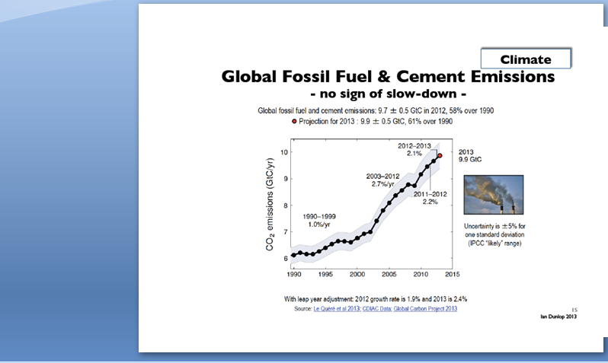

Slide 34
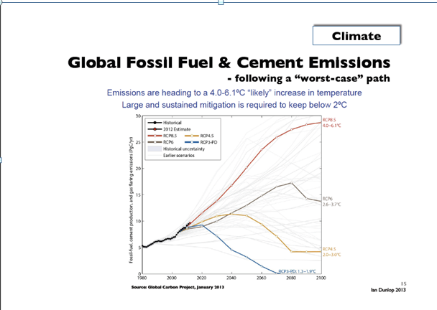

Slide 35
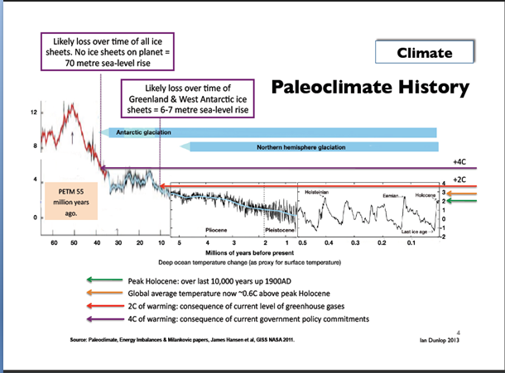

Slide 36
Could modeling/computer-assisted decision-making systems help?
Mesarovic’s NEGOS was deemed to be useful in the 1991 demonstration: 1)in evaluating various negotiating positions and 2) their implications thus 3)reducing the scope of the issues to be negotiated, and time needed for consensus, to manageable proportions
Same true regarding UNFCCC Paris negotiations? Probably true with most advanced systems of today
But are modeling experts ready and is the international community ready ?

Slide 37
Could modeling/computer-assisted decision-making systems help?
A model or various models/decision support systems could
- show how CO2 emissions (or GHG emissions in general) would develop with various negotiation positions by groups and most relevant countries
show likely impact of various draft deals on emissions, temperature rise, sea water rise and other chosen parameters

Slide 38
Could modeling/computer-assisted decision-making systems help?
This new system would be like modified and expanded IPCC system, now interactive, put directly into hands of negotiators
Publicly available system could be given to journalists and NGOs
A game could be developed for youth (with various scary scenarios affecting one’s own environment/neighborhood with various scenarios)

Slide 39
Could modeling/computer-assisted decision-making systems help?
A number of similar carbon tracker websites are available but these should be systematized, expanded and make user- friendly for negotiations
Applications for smart phones: youth could play with different scenarios and learn how the negotiations affect them; could put pressure on negotiations

Slide 40
Could modeling/computer-assisted decision-making systems help?
Should we try again in which we failed in 1991? Yes, our social responsibility but time is short
These ideas could be discussed if a seminar/ symposium/project is established as discussed in recs 1 and 2
I believe model-builders should organize themselves, unite themselves and give their contribution to the international community in a more systematic and bolder way than before
This would be a tribute to Mike Mesarovic and “Mankind at the turning point”

