Slide 1
Crisis of Global Sustainability
Tapio Kanninen
One World Lecture Series
Port Chester, New York
15 January 2014

Slide 2
My thesis and central message of the talk
The globe and human race is facing an unprecedented emergency
Basically, this is due to climate change and a number of interconnected issues (energy use, economic growth, decisions on infrastructure and technology)
Urgency is the key – we cannot any more ignore the fact that decisions to change the course have to be made now, not 5-20 years from now, in other words, postponement for the time there is enough “political will” is not any more sustainable

Slide 3
My message: the UN
The UN is both part of the problem and part of the solution:
Problems of the UN (and I know this out of 30 years of experience at the UN working in international negotiations and policy work in environmental statistics and political affairs):
1) negotiations
2) reports,
3) integrated policy assessment

Slide 4
UN: problems
1) Negotiations: Even after over 20 years of intensive negotiations on climate change both at the technical and political level CO2 emissions have just grown – something fundamentally wrong here
2) Reports: the global emergency is not a central message in reports but is scattered throughout the pages with good analysis of its components but not seeing how all components are intertwined and will together produce a really dim message for the future

Slide 5
UN problems
3) policy planning system at the UN: no integrated system, no facilities for dealing effectively with global emergency occurring simultaneously in a number of interconnected areas

Slide 6
Outline for the talk
1. Evidence that the world is going through a major crisis
2. What should be done?
3. Conclusions

Slide 7
Four very big problems of humankind
1. Global climate change
2. Global problems in energy and resources
3. Interconnectedness between climate change and global energy use
4. Meta-problem: what we do now will determine the global development path for decades and centuries to go
Access to water, global food crisis and world financial crises are all connected to the above problems

Slide 8
BIG PROBLEM 1:Global climate change
Warming of the planet and global CO2 and other green house emissions have continued without interruption

Slide 9
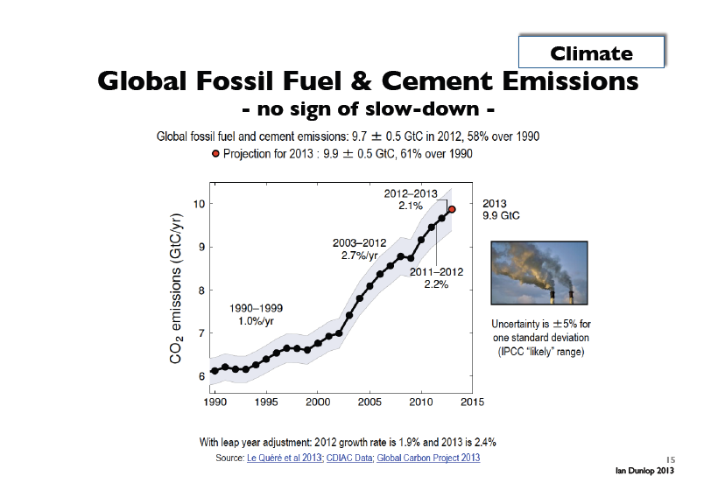

Slide 10
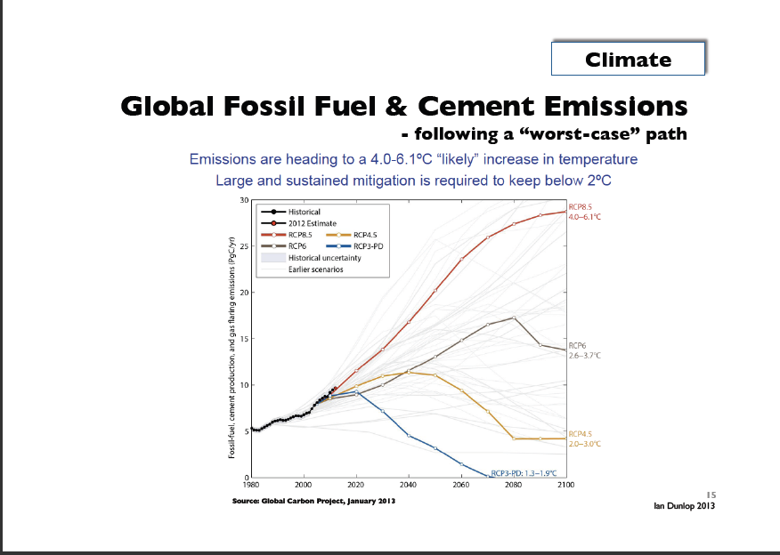

Slide 11
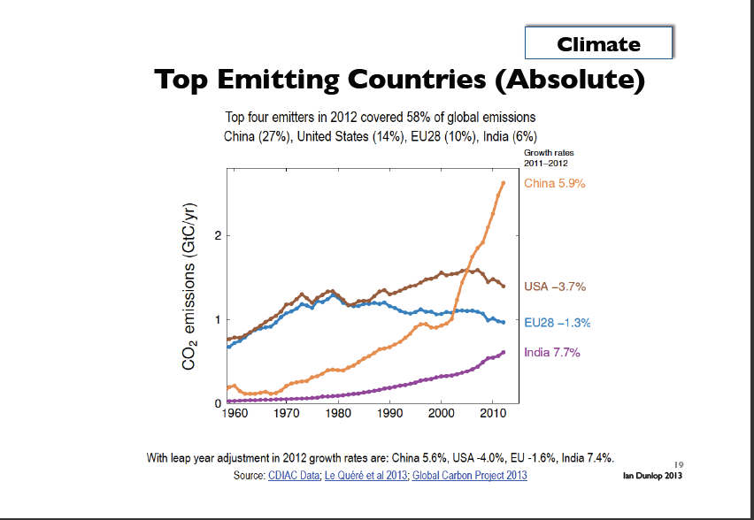

Slide 12
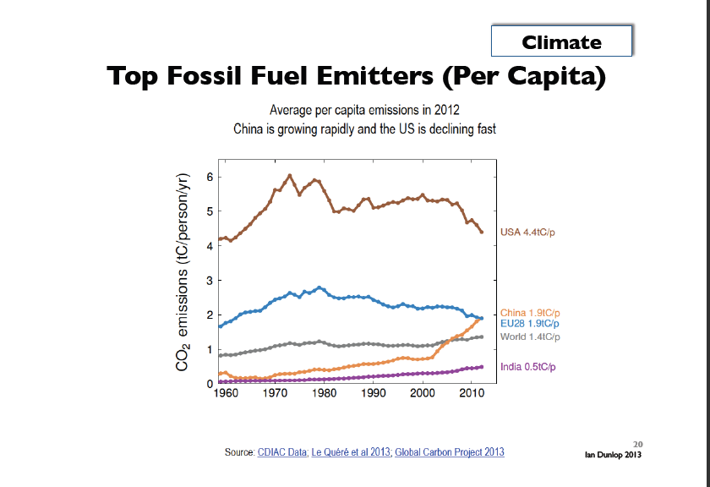

Slide 13
BIGPROBLEM 1:Global climate change
Subproblem 1.1:
Arctic and Antarctica are warming more rapidly than other parts of the world
This trend will intensify the rise of sea-level in the near future

Slide 14
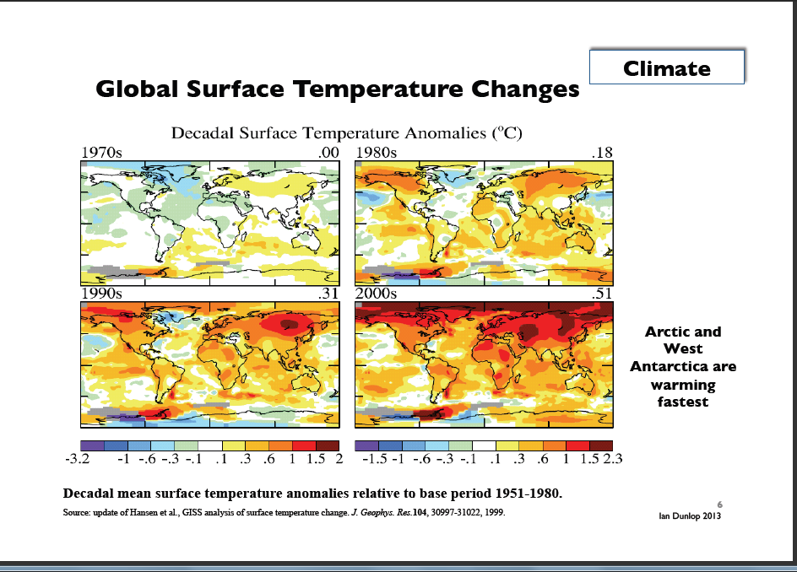

Slide 15
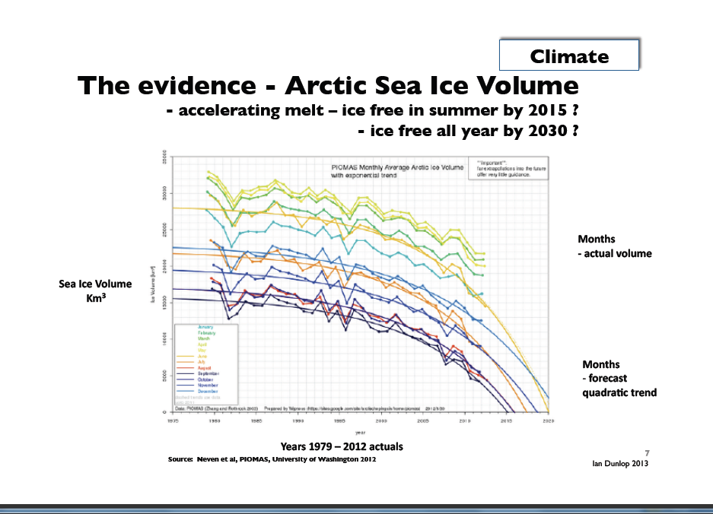

Slide 16
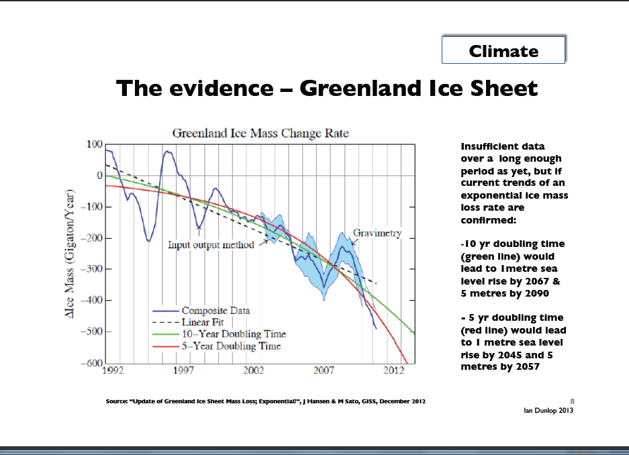

Slide 17
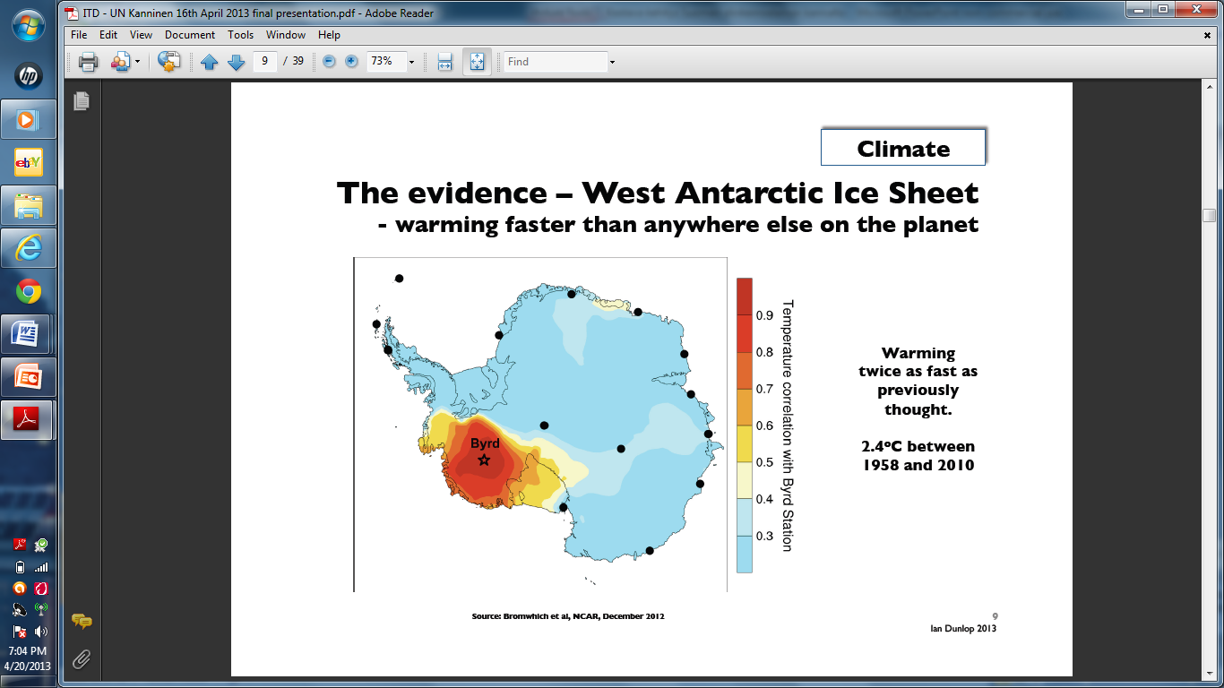

Slide 18
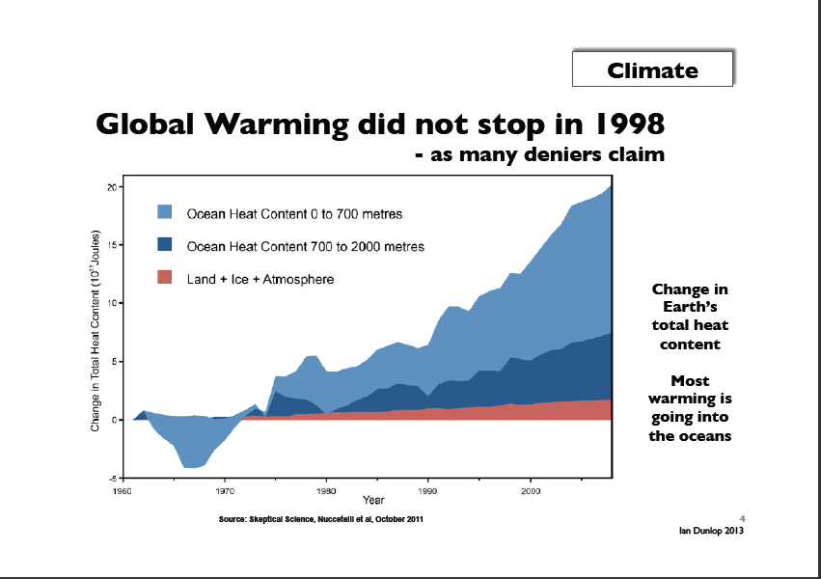

Slide 19
BIG PROBLEM 1:Global climate change
Subproblem 1.2: Tipping Points
Tipping points are irreversible mechanisms that might trigger self-reinforcing catastrophic climate change – some say in a matter of years rather than decades
Scientists have determined some 15 candidates for tipping points

Slide 20
BIG PROBLEM 1:Global climate change
Climate change’s impact on the rise of sea level.
Two schools of thought among climate scientists:
SCHOOL OF THOUGHT 1: Cautious scientists who stress the lack of data and difficulties in methods – sea level would rise ½ - 1 meters in 100 years (IPCC reports)
SCHOOL OF THOUGHT 2: Bolder scientists who do not deny the lack of data and difficulties in methods but try to estimate the impact of tipping points for our decision-making – sea level rise would rise some 5-7 meters in 100 years

Slide 21
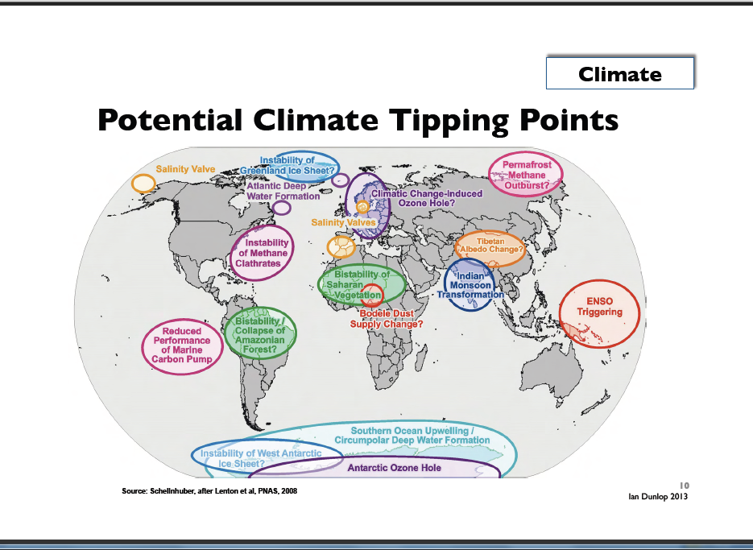

Slide 22
BIG PROBLEM 1:Global climate change
Dr. James Hansen, long-term head of NASA’s Goddard Institute for Space Studies and a leading climate scientist at Columbia University’s Earth Institute
Uses paleoclimate evidendence

Slide 23
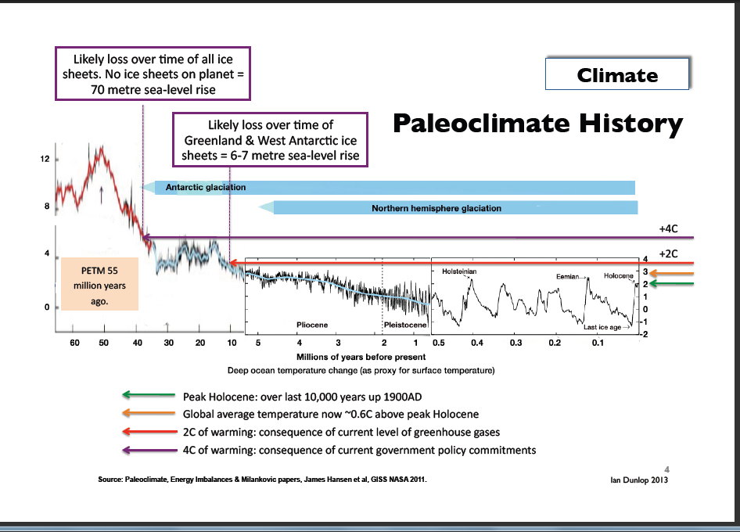

Slide 24
Paleoclimate history: explanation
During this century, we are approaching conditions (CO2 driven temperature increase) that existed 10-40 million years ago. In those conditions back then, there was much less ice - and no ice at all some 40 million years ago - and sea level was 6-70 meters higher than today. The picture shows among other things - and note especially the red horizontal arrow from right (present time) to left (millions years ago) - the concentration of carbon dioxide in the atmosphere and corresponding sea-level rise. The red arrow at your right represents CO2 concentration that we expect to reach when we will meet in a couple of decades the internationally accepted goal of 2 Celsius degrees rise of global temperature compared to preindustrial times. If you follow to the red arrow from right to left you will see that this CO2 concentration was the same the earth had some 10 millions years ago when sea level was 6-7 meters higher than today. WOULD THIS MEAN THAT THE SEA LEVEL HAS TO BE EVENTUALLY 6-7 METERS HIGHER WHEN WE MEET OUR PRESENT CLIMATE CHANGE TARGET? AT LEAST THIS SEEMS LOGICAL.

Slide 25
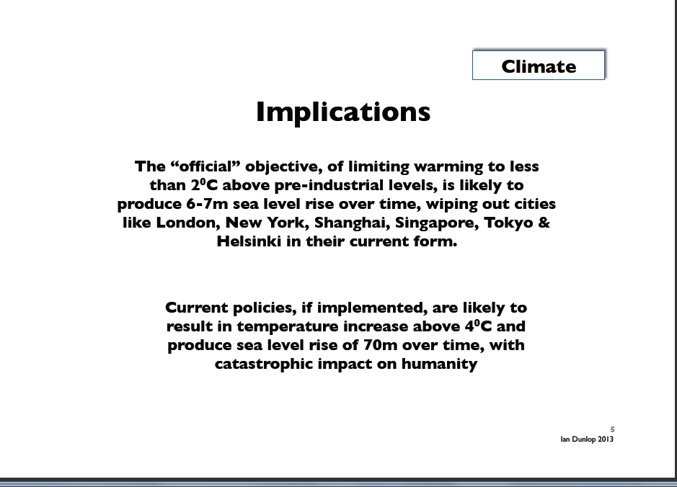

Slide 26
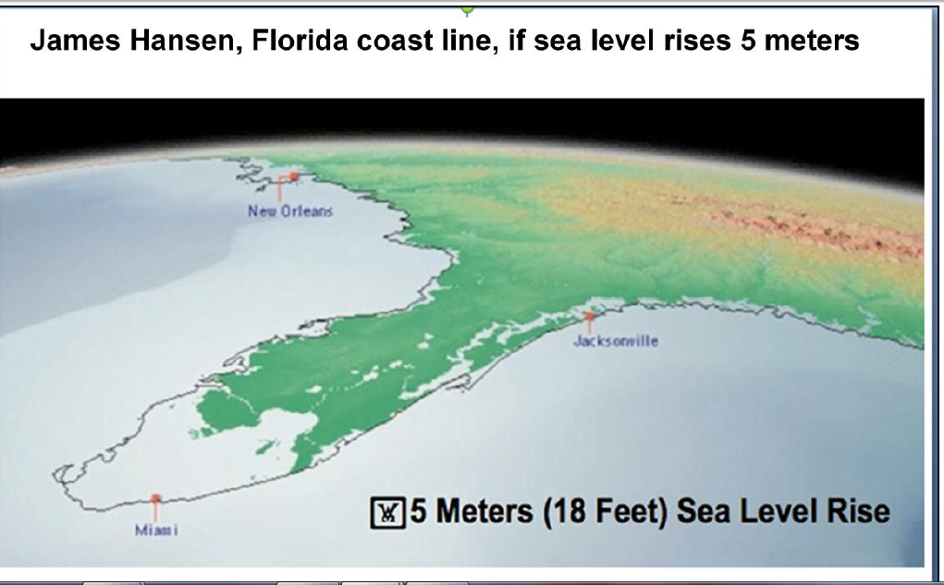
By 2100 or shortly thereafter

Slide 27
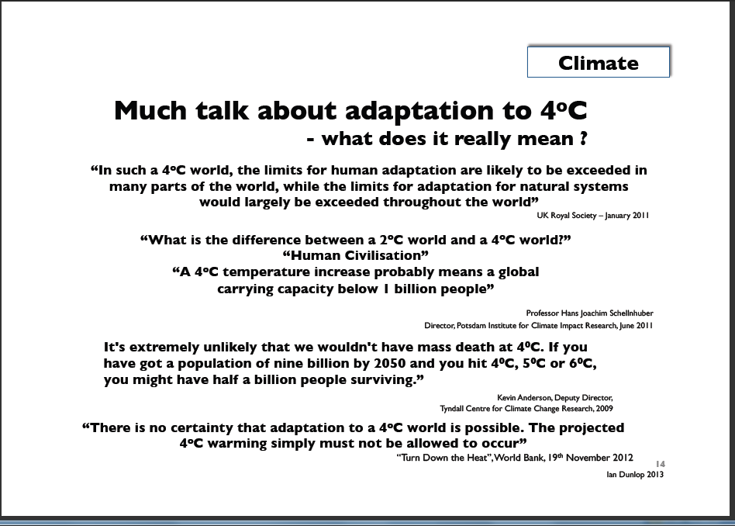

Slide 28
BIG PROBLEM 1:Global climate change
As further evidence that climate is changing rapidly we have an increasing rate of natural catastrophes linked to climate and well as the loss of biodiversity

Slide 29
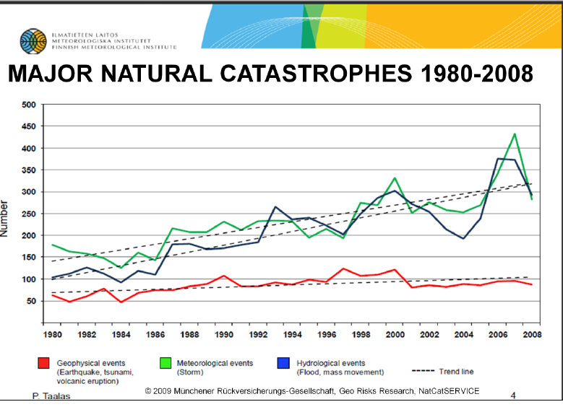

Slide 30
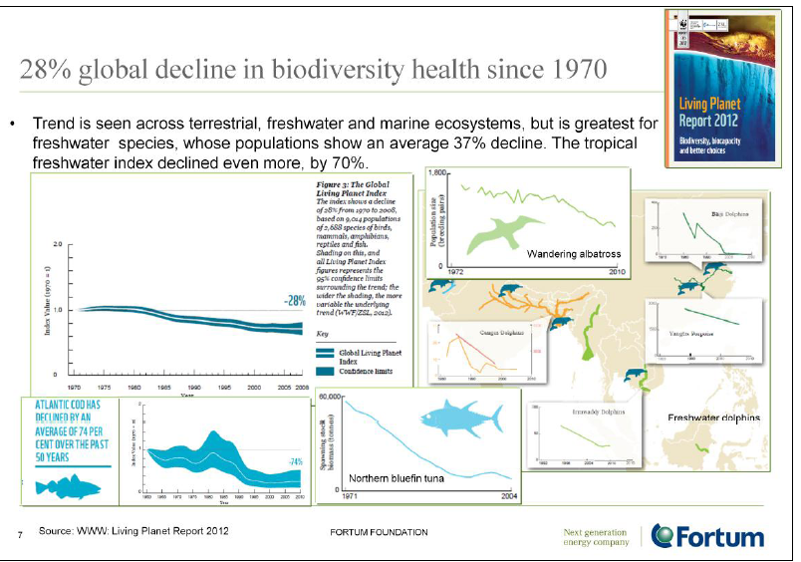

Slide 31
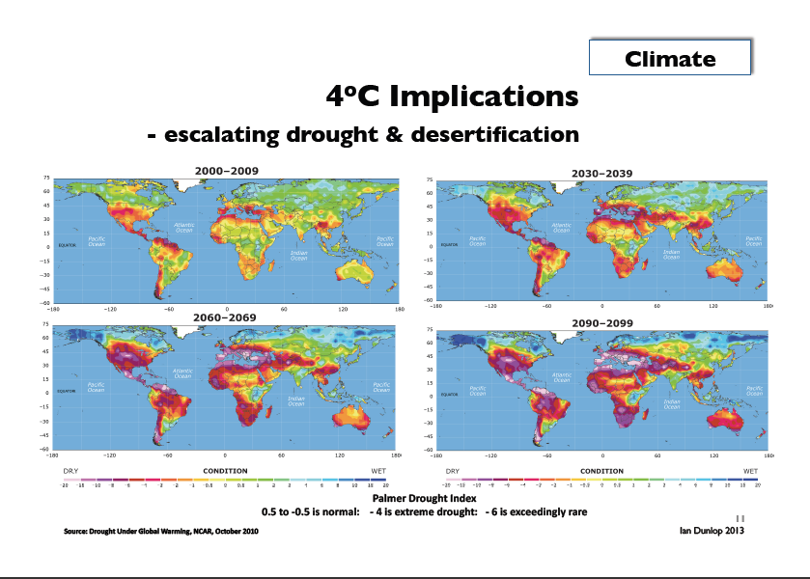

Slide 32
BIG PROBLEM 2: Our resources
Our global wellbeing and economic growth have been measure by national accounts which use Gross National Product (GDP) as a key measurement of growth, but GDP does not tell about the impact of growth on environment
In the future, so called “global ecological footprint” will be in key position
It will ultimately answer the question whether our economic development is based on a Ponzi-scheme in terms of its use of global resources

Slide 33
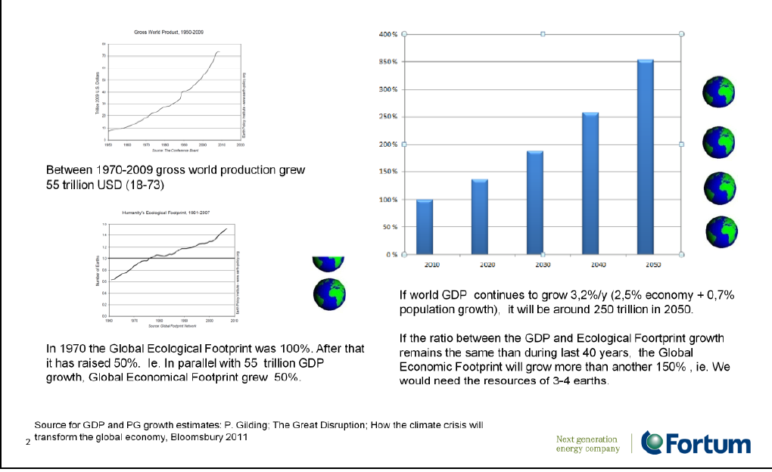

Slide 34
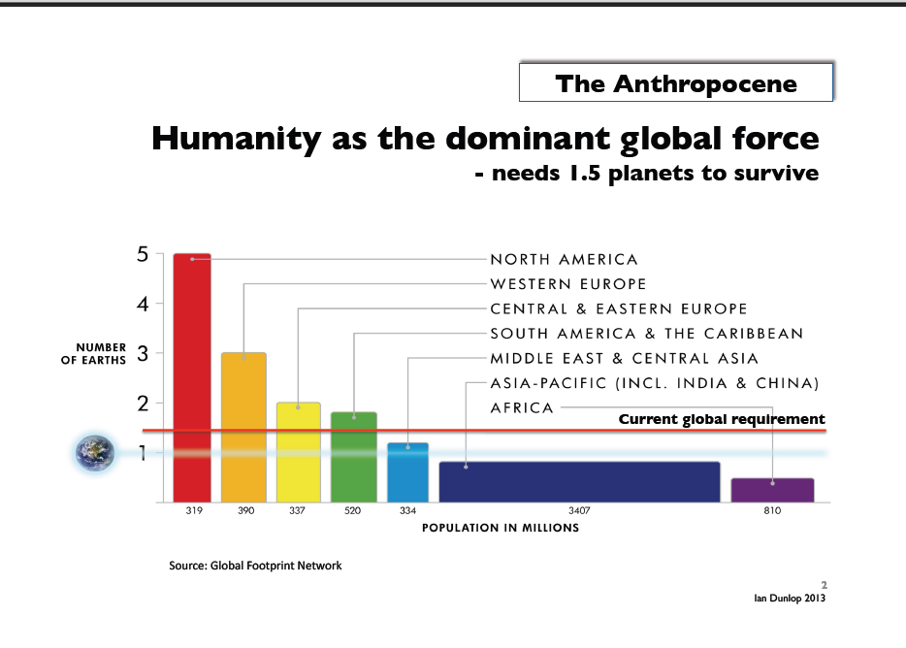

Slide 35
The dropping cost/benefit ratio for oil industry
Subproblem 3.1: The dropping cost/benefit ratio for oil industry
Cost/benefit ratio of oil industry (energy return on energy invested, ERoEI) has dropped during the last decades
To pump oil to the ground needs also energy. Whereas one barrel of oil could produce still in the 1920’s and 1930’s some 100 barrels of oil for consumption, one barrel could only produce some 50 barrels in 1970 and only some 20 barrels this year.
The cost/benefit ratio of gas, coal and renewable energies are clearly lower than oil
Our economic growth has so far based on cheap energy but the era of cheap energy is over!

Slide 36
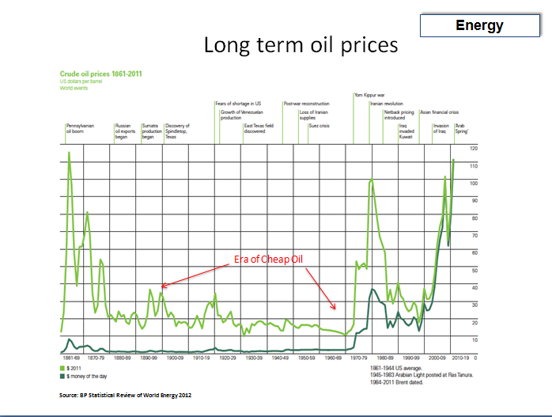

Slide 37
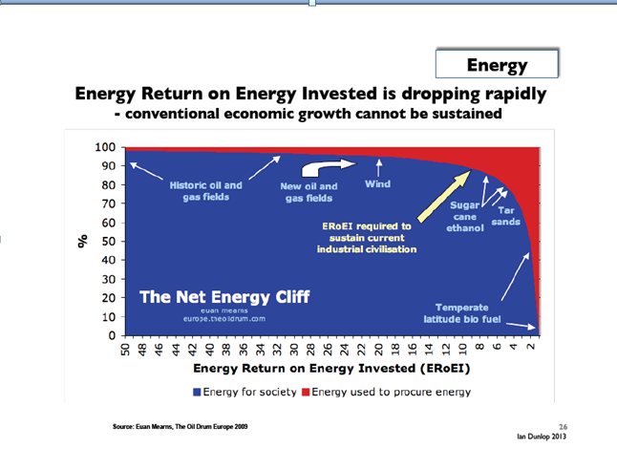

Slide 38
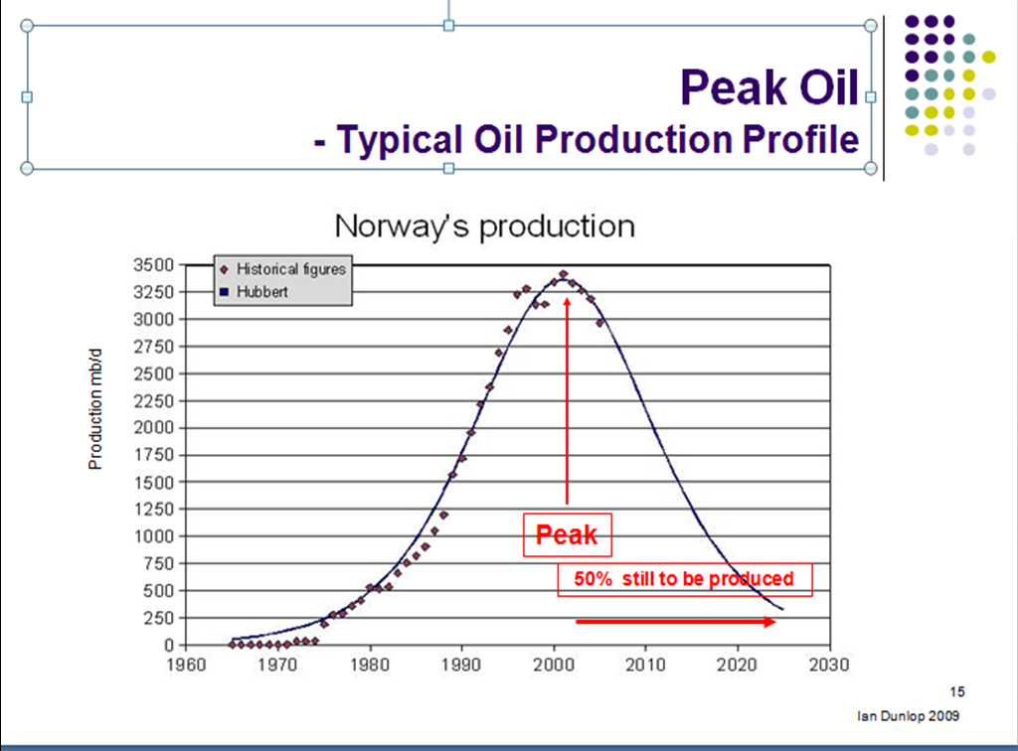

Slide 39
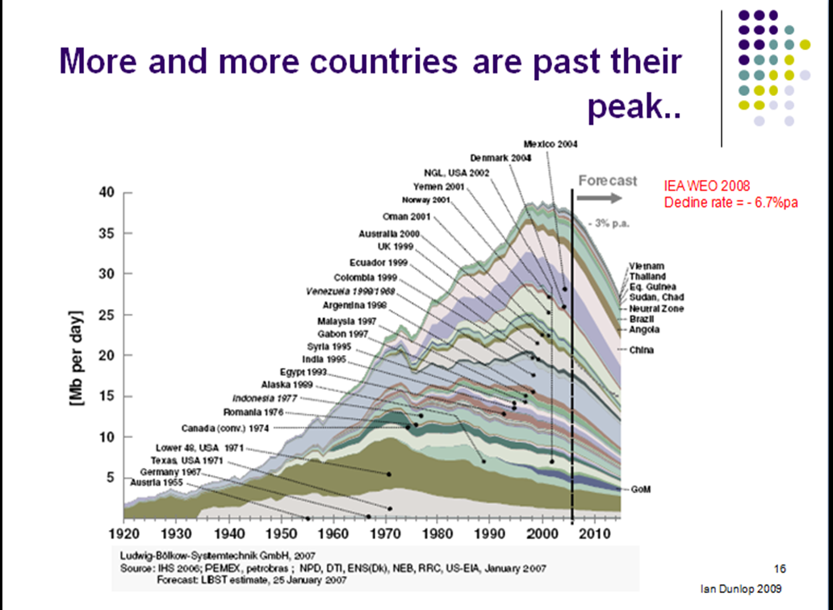

Slide 40
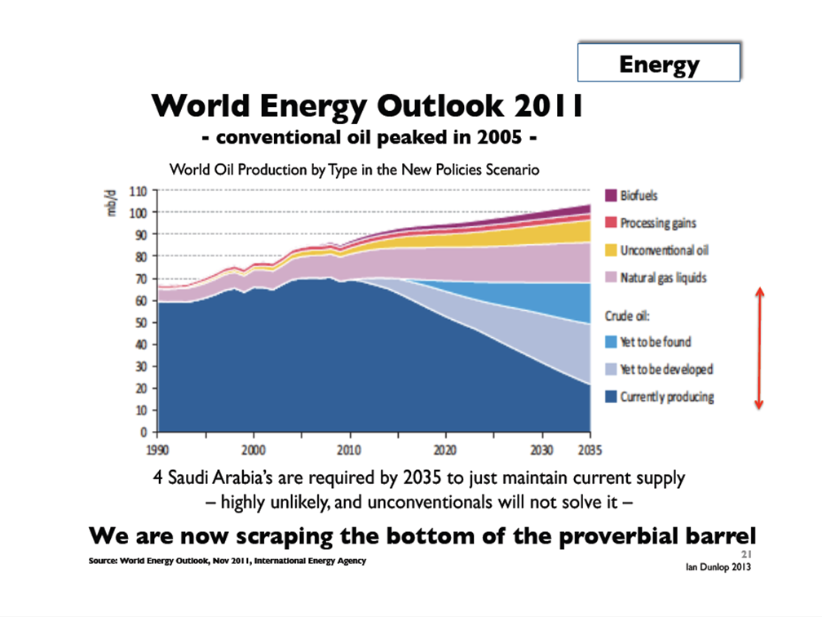

Slide 41
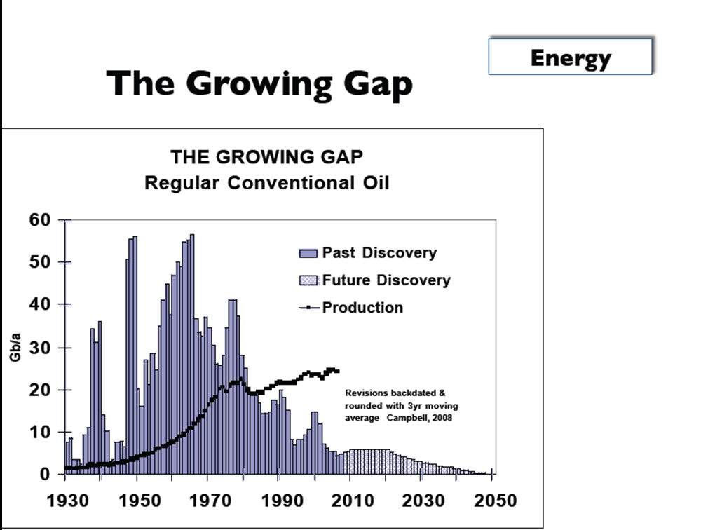

Slide 42
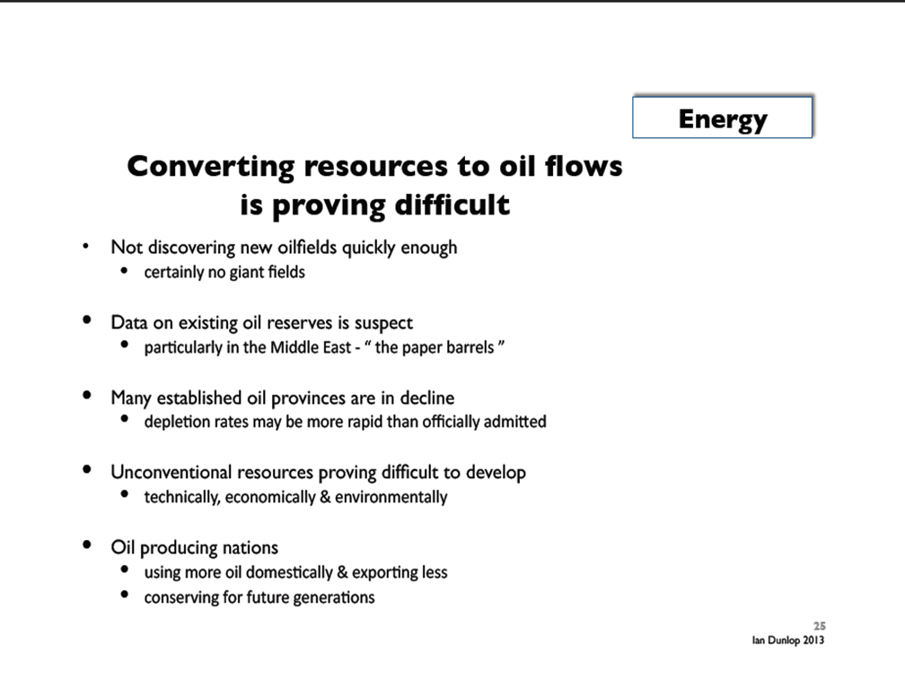

Slide 43
Connections between global economic growth, energy use and climate change
How could we attain 2° C official target in climate change talks and continue our current economic growth and energy use as before?
Ian Dunlop’s theses; Dunlop was Shell’s engineer and senior executive over 30 years as well as the main developer of the carbon emission trading system in Australia

Slide 44
Connections between global economic growth, energy use and climate change
QUESTION NO.1:
Can global economic growth continue whilst simultaneously limiting global temperature increase to 2°C? According to Dunlop the answer is clearly no (albeit the non-availability of cheap energy sources may well itself slow growth quite separately from efforts to limit global warming). We are not running out of either oil, coal, or gas resources—the issue is how to convert these resources into flows to the market in an environmentally and economically acceptable manner or to move to alternative energy sources. Only 30-40 percent of current proven fossil-fuel reserves can be burnt to have a reasonable chance of remaining below the 2°C target.

Slide 45
Connections between global economic growth, energy use and climate change
QUESTION NO. 2:
Can technology help us move quickly to make the use of fossil fuels less polluting so that our economic growth model can continue? The answer is also a clear no. All present technologies to make such a transition would be too expensive, environmentally damaging, and time-consuming.

Slide 46
Connections between global economic growth, energy use and climate change
QUESTION NO. 3:
Can our global economic growth model continue if we quickly move to the alternative energy sources of renewables and nuclear? Here also the answer is a clear no, according to Dunlop, as the present alternatives—primarily solar, wind, and nuclear—contribute only a small proportion of global energy supplies relative to fossil fuels. Thus their replacement of fossil fuels while maintaining global economic growth is highly unlikely in the short term, though it may provide a longer term solution for a steady-state economy.

Slide 47
BIG PROBLEM 4: what we do now will determine the global development path for decades and centuries
The question of urgency

Slide 48
Allison Macfarlane, chair of BAS’ Science and Security Board :
After the Doomsday Clock was moved in January 2012 back one minute, now 5 minutes to midnight – from nuclear holocaust to environmental holocaust:
“The global community may be near a point of no return in efforts to prevent catastrophe from changes in Earth’s atmosphere. The International Energy Agency projects that, unless societies begin building alternatives to carbon-emitting energy technologies over the next five years, the world is doomed to a warmer climate, harsher weather, droughts, famine, water scarcity, rising sea levels, loss of island nations, and increasing ocean acidification.”
“Since fossil-fuel burning power plants and infrastructure built in 2012-2020 will produce energy—and emissions—for 40 to 50 years, the actions taken in the next few years will set us on a path that will be impossible to redirect. Even if policy leaders decide in the future to reduce reliance on carbon-emitting technologies, it will be too late.”

Slide 49
EU/Council of Europe: global climate change targets
In order to reach 2°C climate change target:
EU: CO2 reduction by 2050 80% compared to the level of 2005
Council of Europe: reduction of green house emissions by 2050 80-95% compared to 2005 level
REALISM CHECK: Exxon expects the developed countries to reduce only 20% CO2 emissions and developing countries increasing emissions by 50% by 2040

Slide 50
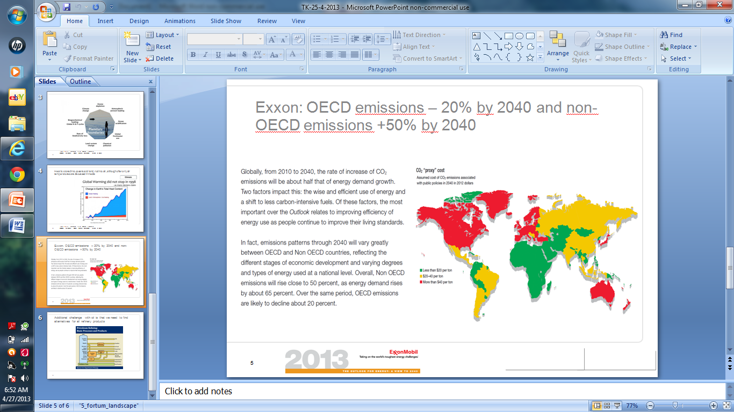

Slide 51
What should be done?
2015 Paris UNFCCC agreement
Change the UN
Create a new global paradigm for change
Mobilize the masses, youth, world citizens

Slide 52
For UN climate meeting in 2015: cap-and-trade?
We should use the current wealth created by "oil economy" and transform that money into clean energy. The best way would be to calculate how much CO2 we could still emit into atmosphere divide that by next 50 years by a down hill curve, split annual emissions as carbon credits and let scarcity in the markets take care the reduction. This cap-and-trade-mechanism was used when SO2 problem was solved in North America 1993-2003 with excellent results.
For clean investments, carbon price should be at least 30 €/t, i.e. ten times the current price level. There is a large consensus that this alone would attract investments switching away from coal. Instead of subsidizing oil, countries could start to create mechanisms (like national or international CDM) to increase renewable solutions like solar panels. This would be especially helpful in developing countries.
In order to get a binding international agreements on these issues all efforts should be focused into UN climate meeting in Paris in 2015.

Slide 53
For 2015 agreement: change the flow of energy subsidies
We are today heavily dependent on fossil fuels. Scientists say that we could only use about 20-40% of the existing known reserves in order to reach the international standard of 2 °C increase in global atmospheric temperature. And still our oil companies are investing annually some 600-700 billion USD to find new reserves and governments give fossil fuel subsidies annually over 500 billion USD. And we have plans to build new coal fired power stations with over 1 trillion USD.
Renewable investments were last year only on the level 250 billion USD and subsidies 88 billion USD. This means that the money flow into fossil energy is about 3-4 times bigger than into renewables. If we cannot change this flow in coming years we are not able to develop clean energy fast enough and we could have a major economic collapse, if (or when) some climate change related "Pearl Harbor event" will hit us and we will have a panic exit from investments into fossil companies and use of fossil energy. This would then make many countries to collapse financially. After that we would have no money to change into clean energy.

Slide 54
Creating a new global emergency paradigm
As it is not realistic to create a global cap-and-trade system by 2015 – too many national, vested and political interests and obstacles – other measures should be taken up at the same time:
1) UN role could be sharpened
2) activate scientists and scholars to be bolder
3) create mass movements to spread awareness of a runaway climate change and urgency of action to stop it before it is too late

Slide 55
UN’s new role
Secretary-General Ban Ki-moon has been active but should start to act together with heads of IMF, the World Bank and some other heads of major organizations
UN reports should become sharper putting out a global emergency message (even if some Member States would object)
Organizationally, the UN should establish a truly multidisciplinary policy planning capacity and global emergency unit at the level of the Office of the Secretary-General

Slide 56
Civil society, media
Mobilize rock stars, movie stars, film directors, painters and other artists to speak about a global emergency
Arrange concerts and documentaries on the same
The above has been done to some extent, but a critical mass has not yet been created as things go as before in terms of CO2 emissions

Slide 57
More radical solution: change the global governance system
In my book “Crisis of Global Sustainability” (Routledge, 2013) I promoted a long-term global governance change for the world:
1) long term: a complete overhaul of the UN system
2) some emergency measures

Slide 58
Long-term global governance change
Once the severity of the crisis is accepted worldwide, or by the majority of governments, a second conference of the UN Charter, foreseen in its article 109, should be called for. A collective decision to do so is important in order to start a democratic process with all countries and other stakeholders involved to first fully understand all aspects the crisis, and, secondly, jointly to seek organizational innovations and processes needed to solve it.
This conference could take a long time to produce results, as in fact the outcome would be a new governance structure for the world. Therefore, it would be wise to complement it with other initiatives—to be taken separately or jointly by governments, academia, corporations and civil society.
When creating new institutions and initiatives it would be important secure the maintenance of major achievements of the twentieth century in the area of democracy and human rights.

Slide 59
Short-term emergency measures
The establishment of a global crisis center, or 24-hour operations room, to monitor the global emergency. The Carbon War Room set up by Sir Richard Branson could form part of the center or be closely associated. It might form part of the new global governance architecture once the UN review conference has completed its work; and
The establishment of a global network of institutions, universities, and regional, national and local centers, with a focal point in New York close to the UN, to coordinate and catalyze global, regional, national, and local initiatives to solve the various aspects of the crisis. Again the structure could eventually be part of the new global governance architecture.

Slide 60
Conclusions
The globe is soon hitting its limits, or has done already so, as the policies of governments and corporations have not changed much over the last decades
Early warning was given already some 40 years ago e.g. in the “The Limits to Growth” study presented to the Club of Rome and recent scholarly articles have reassessed that its projections were largely accurate
Some scholars are pessimistic, like James Lovelock, that no major policy change will come - and some are hopeful like Paul Gilding but in his view we need a Pearl Harbor moment, an event of the magnitude of Hitler's invasion to Poland to really awaken the humanity to the severity of the crisis

Slide 61
Conclusions
I believe the youth – the real victims of future crises - and using the social media will be the key ; “Occupy Wall Street” movement changed the presidential debate in the US in a matter of weeks even if the new agenda did not last very long – things can really change quickly
Occupy Wall Street and similar social movements should in my view refocus their ideology to the survival of the human race - FROM “OCCUPY WALL STREET” TO “SAVE WALL STREET” (as sea-level rise threatens lower levels of Manhattan as hurricane Sandy demonstrated)
Initiating green projects at the grass root level is also essential as well as networking throughout the world
Efforts should be taken to ensure that a new set of values – keeping the interests of future generations in mind – should govern the new global, regional, national and local institutions that are to be set up to manage the crisis.

Slide 62
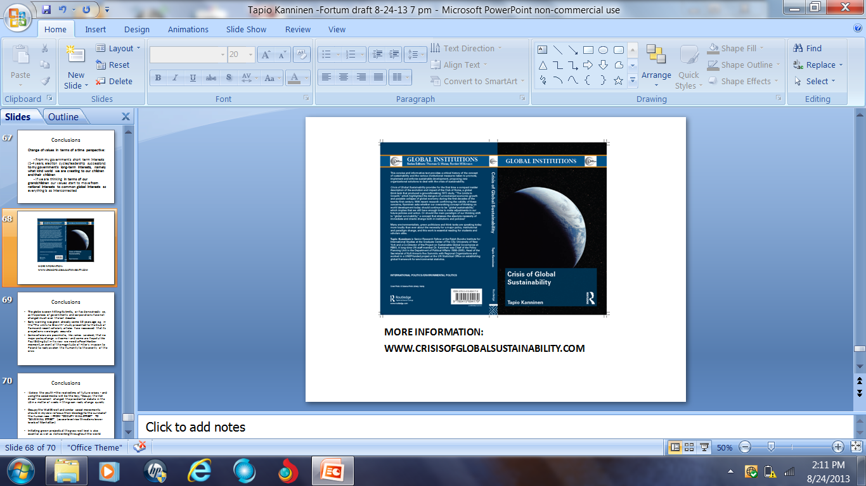
More information

