Slide 1
Sustainable Development Goals and the Post-2015 Development Agenda from the Point of View of Global Sustainability and Survivability
Tapio Kanninen
One UN New York Hotel
11 October 2013

Slide 2
Thesis of presentation
All UN documents on Sustainable Development Goals (SDGs) or Post-2015 Development Agenda (post-2015) are based on “business as usual” approach on world developments in coming decades.
I would like to contest that assumption and present an alternative paradigm: climate change (and related economic and social disruptions) will change fundamentally the ways we are doing our business and will create a new world and a new political and economic order.

Slide 3
Thesis of presentation (cont.)
We are already in, or are approaching the tipping points of, a global emergency because of climate change and as changes (economic and political) to correct the course worldwide are so demanding, overwhelming.
Challenge: the impact of climate change, although becoming more evident, is not likely to be very dramatic in the next 5-15 years forcing us to think that business-as-usual approach can continue.

Slide 4
Thesis of presentation (cont.)
Due to rapid climate change we have to take a longer time view than usually and see how climate change, energy use, economic growth and socio-economic progress are all interrelated.
At the same time as we think post-2015-SDGs we have to start thinking also post-2050-SDGs and post-2050 Development Agenda in a totally new global situation.

Slide 5
High-level Panel of Eminent Persons on the Post-2015 Development Agenda
“Above all there is one trend – climate change – which will determine whether or not we can deliver on our ambitions.”
“While we are writing this report, the world passed an alarming threshold: atmospheric carbon dioxide concentration was measured at over 400 parts per million, probably the highest level in at least 800,000 years. There is not evidence yet that the upward trend has been slowed or reversed, as it must be if potentially catastrophic changes in climate are to be avoided.”
“Scientists warn us that we must aggressively move beyond current voluntary pledges and commitments to reduce carbon emission or else we will be on a path to at least a 4-degree Celsius warming over pre-industrial level by this century’s end. According to World Bank, such 4 C scenarios would be devastating.”

Slide 6
Thesis of presentation
But High-level Panel just hoped that the international community could reduce CO2 and other green house emissions and keep the temperature increase below 2 degrees Celsius – there is no evidence that this will be the case.
In fact the odds are clearly against this wishful thinking as both national and fossil fuel industry interests are dominating the negotiation environment.
The global change required to move quickly from fossil fuel based industries to a renewables-based global economy is unprecedented in order to avoid a run-away climate change.
Therefore, realistic SDGs should see where the world is going until 2100 with business-as-usual scenarios dominating and move backwards to set up targets for us from this longer-term perspective.

Slide 7
Thesis of presentation
The SDG-goals and targets should be VEHICLES FOR CHANGE IN THE RIGHT DIRECTION.
THE GOALS AND TARGETS SHOULD NOT BE BASED ON THE ASSUMPTION THAT GOVERNMENTS WOULD REACH A BINDING, MEANINGFUL, ENFORCEABLE CLIMATE CHANGE DEAL IN 2015 (based on historic evidence in Kyoto and Copenhagen).
More realistic: CO2 EMISSIONS WILL CONTINUE TO GROW – THEREFORE SDG-GOALS AND TARGETS SHOULD TRY TO REVERSE THIS TREND !

Slide 8
Thesis of presentation
Eventual change of focus from short-term to long-term SDGs is not going to be easy.
UN System Task Team on the Post-2015 UN Development Agenda (July 2013) saw this change in this way: “..it has been the experience thus far that sustainability targets going beyond descriptive measures will be hard to achieve in this politically fraught area. Even the selection of benchmark and target dates for sustainability indicators is controversial, as environmental damages have accrued over a long period and their long-term trajectories, say to 2050 and beyond, may be much more critical, even catastrophic, than a trend over 5-10 years would suggest.”
This phrase “ long term trajectories, say 2050 and beyond, may be much more critical, even catastrophic…”should be our starting point for any serious work in this area.

Slide 9
Outline for the talk
1. Evidence that business-as-usual model is not providing a realistic scenario for SDGs (for more details go for presentations at http://www.clubofrome.org/?p=5984)
2. Alternative look at the warming planet and what this means for SDGs and the Development Agenda whatever the time frame
3. Conclusions and recommendations

Slide 10
Four very big problems of humankind
1. Global climate change
2. Global problems in energy and resources
3. Interconnectedness between climate change and global energy use
4. Meta-problem: what we do now will determine the global development path for decades and centuries to go
Access to water, global food crisis and world financial crises are all connected to the above problems

Slide 11
BIG PROBLEM 1:Global climate change
Warming of the planet and global CO2 and other green house emissions have continued without interruption

Slide 12
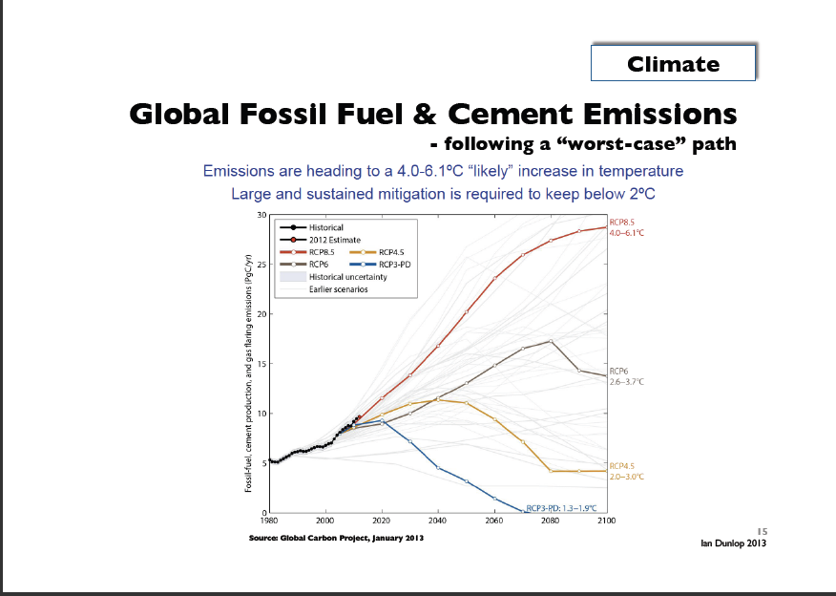

Slide 13
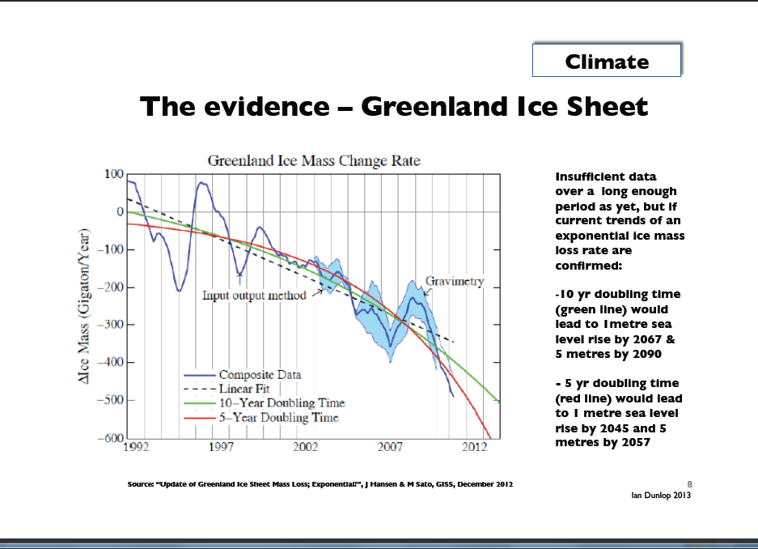

Slide 14
BIG PROBLEM 1:Global climate change
Subproblem 1.2: Tipping Points
Tipping points are irreversible mechanisms that might trigger self-reinforcing catastrophic climate change – some say in a matter of years rather than decades.
Scientists have determined some 15 candidates for tipping points.

Slide 15
BIG PROBLEM 1:Global climate change
Climate change’s impact on the rise of sea level.
Two schools of thought among climate scientists:
SCHOOL OF THOUGHT 1: Cautious scientists who stress the lack of data and difficulties in methods – sea level would rise ½ - 1 meters in 100 years (e.g. IPCC reports).
SCHOOL OF THOUGHT 2: Bolder scientists who do not deny the lack of data and difficulties in methods but try to estimate the impact of tipping points for our decision-making – sea level rise would rise some 5-7 meters even in 100 years in a worst case scenario.

Slide 16
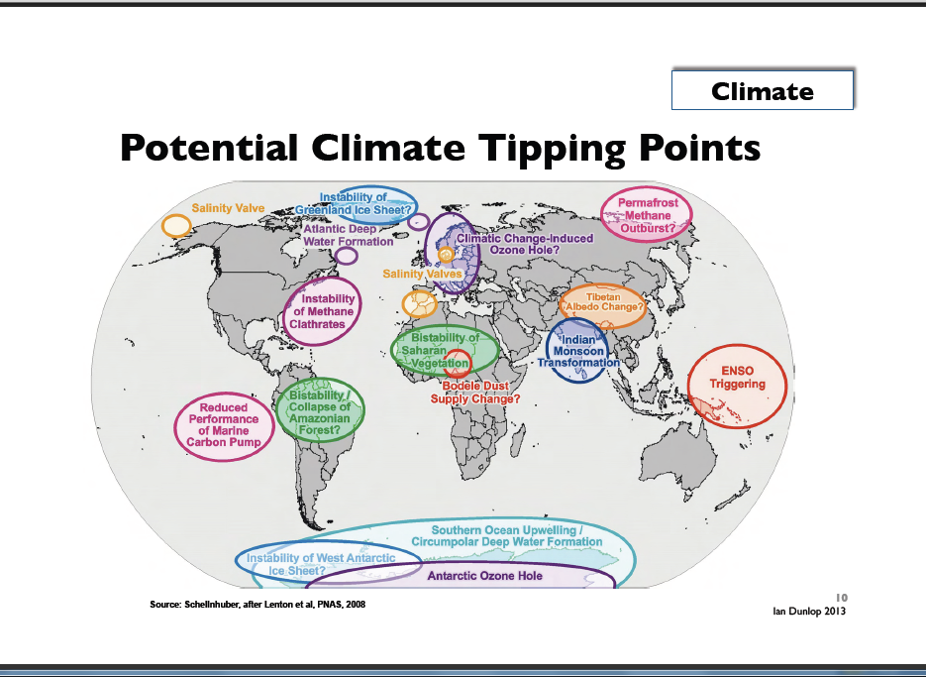

Slide 17
BIG PROBLEM 1:Global climate change
Dr. James Hansen was a long-term head of NASA’s Goddard Institute for Space Studies and a leading climate scientist at Columbia University’s Earth Institute.
Uses paleoclimate evidence (see next slide and the following slide for its explanation).

Slide 18
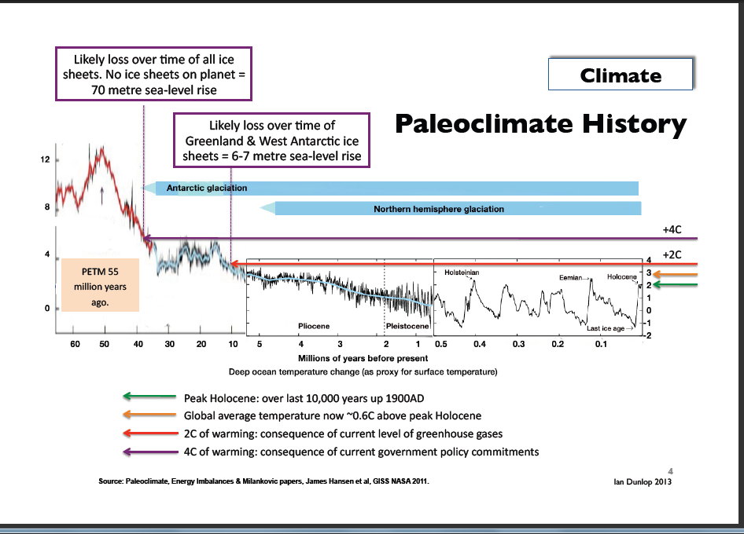

Slide 19
Paleoclimate history slide: explanation
During this century, we are approaching conditions (CO2 driven temperature increase) that existed 10-40 million years ago. In those conditions back then, there was much less ice - and no ice at all some 40 million years ago - and sea level was 6-70 meters higher than today. The picture shows among other things - and note especially the red horizontal arrow from right (present time) to left (millions years ago) - the concentration of carbon dioxide in the atmosphere and corresponding sea-level rise. The red arrow at your right represents CO2 concentration that we expect to reach when we will meet in a couple of decades the internationally accepted goal of 2 Celsius degrees rise of global temperature compared to preindustrial times. If you follow to the red arrow from right to left you will see that this CO2 concentration was the same the earth had some 10 millions years ago when sea level was 6-7 meters higher than today. WOULD THIS MEAN THAT THE SEA LEVEL HAS TO BE EVENTUALLY 6-7 METERS HIGHER WHEN WE MEET OUR PRESENT CLIMATE CHANGE TARGET? AT LEAST THIS SEEMS LOGICAL.

Slide 20
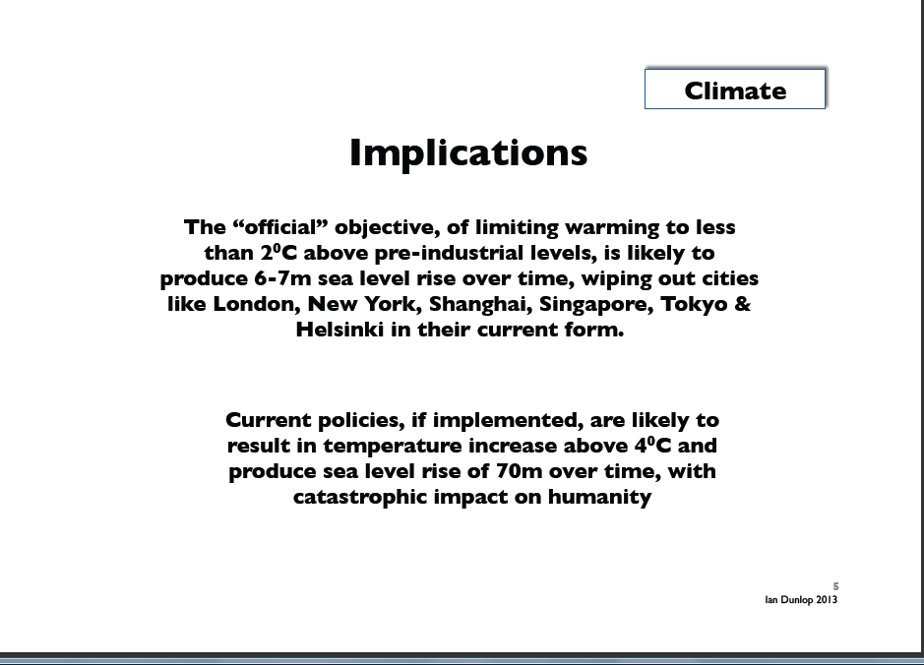

Slide 21
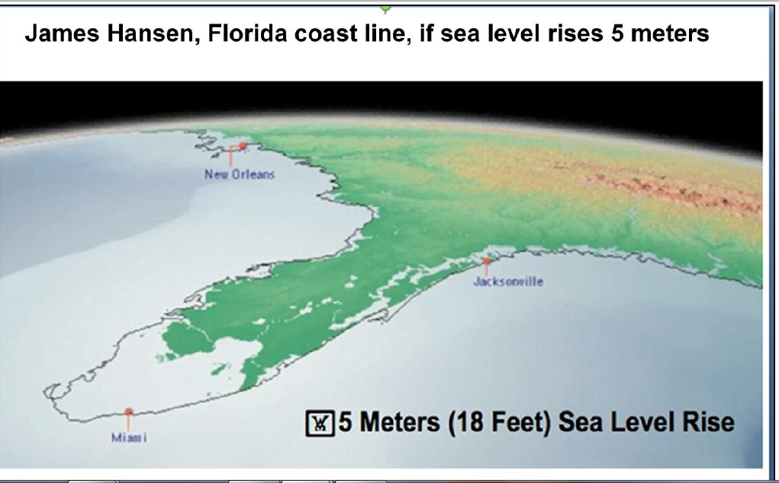
By 2100 or shortly thereafter

Slide 22
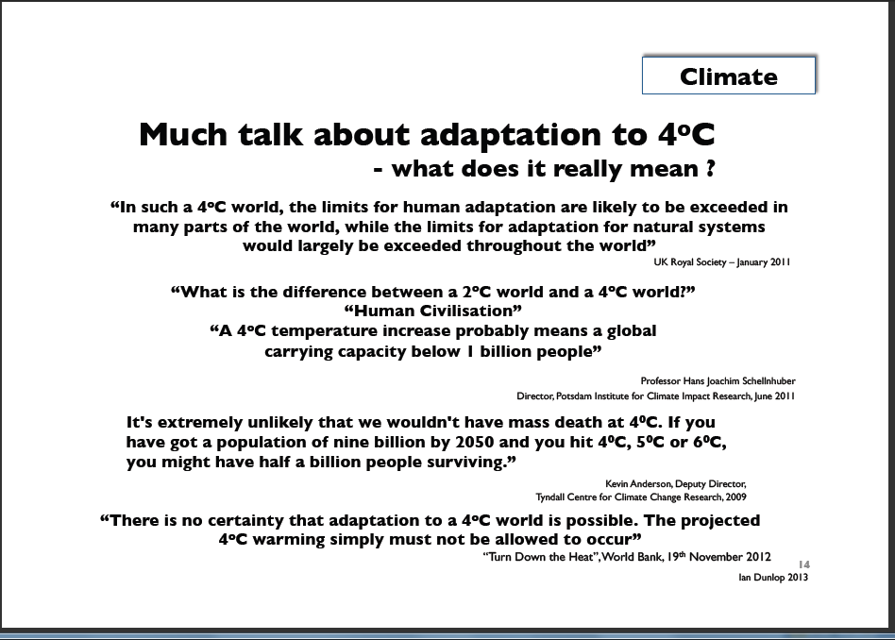

Slide 23
BIG PROBLEM 2: Our resources
Our global wellbeing and economic growth have been measure by national accounts which use Gross National Product (GDP) as a key measurement of growth, but GDP does not tell about the impact of growth on environment.
In the future, so called “global ecological footprint” will be in key position.
It will ultimately answer the question whether our economic development is based on a Ponzi-scheme in terms of its use of global resources.

Slide 24
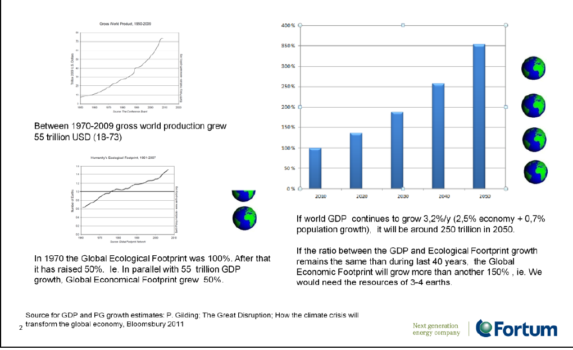

Slide 25
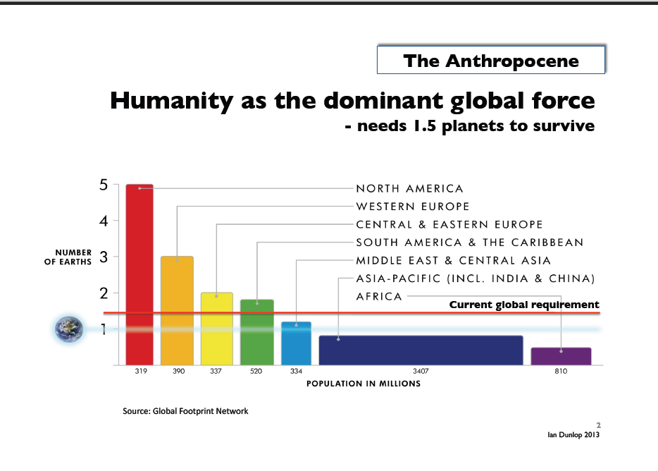

Slide 26
BIG PROBLEM 3. Interconnectedness between climate change and global energy use
How could we attain 2° C official target in climate change talks and continue our current economic growth and energy use as before?
Ian Dunlop’s theses; Dunlop was Shell’s engineer and senior executive over 30 years as well as the main developer of the carbon emission trading system in Australia.

Slide 27
Connections between global economic growth, energy use and climate change
QUESTION NO.1:
Can global economic growth continue whilst simultaneously limiting global temperature increase to 2°C? According to Dunlop the answer is clearly no (albeit the non-availability of cheap energy sources may well itself slow growth quite separately from efforts to limit global warming). We are not running out of either oil, coal, or gas resources—the issue is how to convert these resources into flows to the market in an environmentally and economically acceptable manner or to move to alternative energy sources. Only 30-40 percent of current proven fossil-fuel reserves can be burnt to have a reasonable chance of remaining below the 2°C target.

Slide 28
Connections between global economic growth, energy use and climate change
QUESTION NO. 2:
Can technology help us move quickly to make the use of fossil fuels less polluting so that our economic growth model can continue? The answer is also a clear no. All present technologies to make such a transition would be too expensive, environmentally damaging, and time-consuming.

Slide 29
Connections between global economic growth, energy use and climate change
QUESTION NO. 3:
Can our global economic growth model continue if we quickly move to the alternative energy sources of renewables and nuclear? Here also the answer is a clear no, according to Dunlop, as the present alternatives—primarily solar, wind, and nuclear—contribute only a small proportion of global energy supplies relative to fossil fuels. Thus their replacement of fossil fuels while maintaining global economic growth is highly unlikely in the short term, though it may provide a longer term solution for a steady-state economy.

Slide 30
BIG PROBLEM 4: what we do now will determine the global development path for decades and centuries
The question of urgency

Slide 31
Allison Macfarlane, chair of BAS’ Science and Security Board :
After the Doomsday Clock was moved in January 2012 back one minute, now 5 minutes to midnight – from nuclear holocaust to environmental holocaust:
“The global community may be near a point of no return in efforts to prevent catastrophe from changes in Earth’s atmosphere. The International Energy Agency projects that, unless societies begin building alternatives to carbon-emitting energy technologies over the next five years, the world is doomed to a warmer climate, harsher weather, droughts, famine, water scarcity, rising sea levels, loss of island nations, and increasing ocean acidification.”
“Since fossil-fuel burning power plants and infrastructure built in 2012-2020 will produce energy—and emissions—for 40 to 50 years, the actions taken in the next few years will set us on a path that will be impossible to redirect. Even if policy leaders decide in the future to reduce reliance on carbon-emitting technologies, it will be too late.”

Slide 32
Global long-term targets of climate change
In order to reach 2°C climate change target:
EU: CO2 reduction by 2050 80% compared to the level of 2005
Council of Europe: reduction of green house emissions by 2050 80-95% compared to 2005 level
REALISM CHECK: Exxon expects the developed countries to reduce only 20% CO2 emissions and developing countries increasing emissions by 50% by 2040!

Slide 33
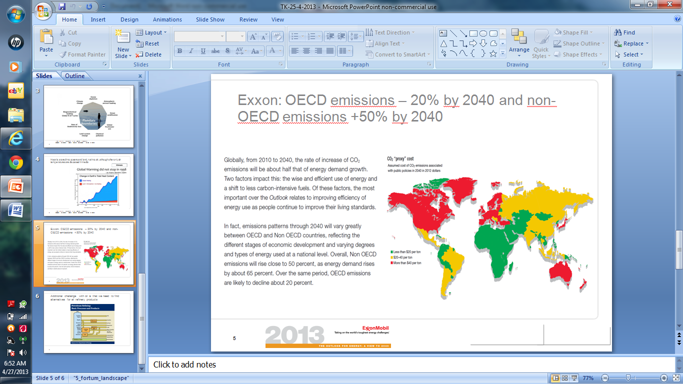

Slide 34
Global emergency and SDGs and post-2015 agenda
What does the global emergency mean for SDGs and for post-2015 development agenda?
Goals, targets and indicators considered need a new interpretation.
Let’s see what High-level Panel of Eminent Persons on the Post-2015 Development Agenda suggested: 12 universal goals, national targets:

Slide 35
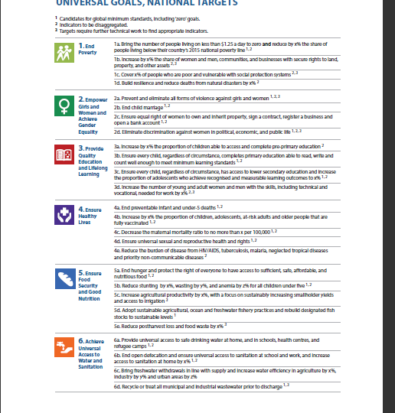

Slide 36
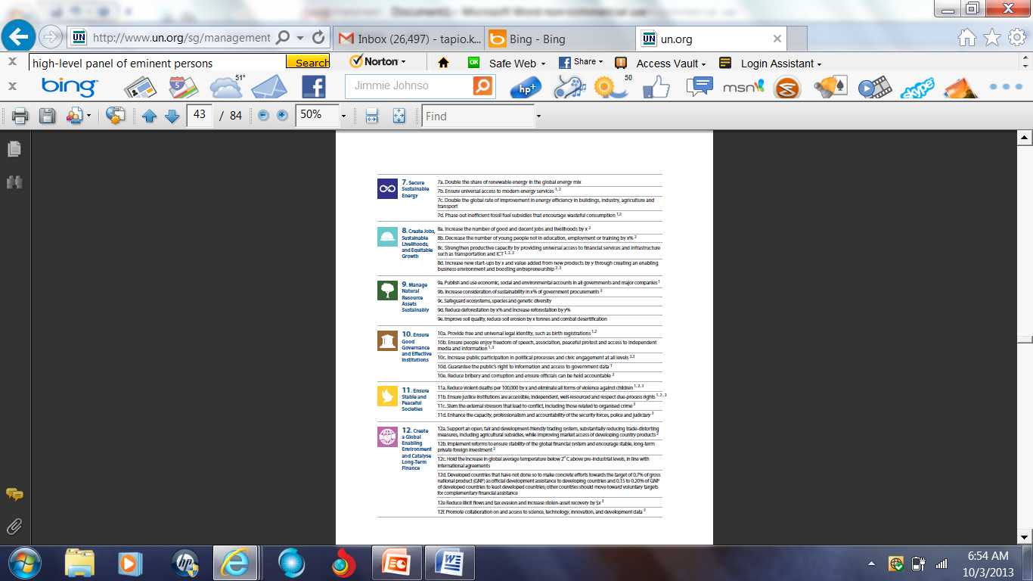

Slide 37
Example: Goal 7: Secure sustainable energy
Panel proposed among others: “double the share of renewable energy in the global energy mix” – this is positive but doubling is not enough.
Panel also proposed: “Phase out inefficient fossil fuel subsidies that encourage wasteful consumption.” – this should be sharpened and made more ambitious:

Slide 38
Goal 7: Secure sustainable energy
We are today heavily dependent on fossil fuels. Scientists say that we could only use about 20-40% of the existing known reserves in order to reach the international standard of 2 °C increase in global atmospheric temperature. And still our oil companies are investing annually some 600-700 billion USD to find new reserves and governments give fossil fuel subsidies annually over 500 billion USD. And we have plans to build new coal fired power stations with over 1 trillion USD.
Renewable investments were last year only on the level 250 billion USD and subsidies 88 billion USD. This means that the money flow into fossil energy is about 3-4 times bigger than into renewables. If we cannot change this flow in coming years we are not able to develop clean energy fast enough and we could have a major economic collapse, if (or when) some climate change related "Pearl Harbor event" will hit us and we will have a panic exit from investments into fossil companies and use of fossil energy. This would then make many countries to collapse financially. After that we would have no money to change into clean energy. Many countries could have deep problems like Greece or Syria have now.

Slide 39
How to build global-emergency-based SDGs?
We could get some help if we can imagine how the world will look like in concrete terms when global warming continues and intensifies.
Mark Lynas’ “Six Degrees” book about how the world will look like in various stages of global warming - from 1 degree to 6 degrees - was published in 2008.
Translated into 22 languages; published by National Geographic. It was based only on peer-reviewed scientific papers and publications.
Won UK Royal Society’s Science Book of the Year in 2008.
National Geographic released a documentary based on the book in 2008.

Slide 40
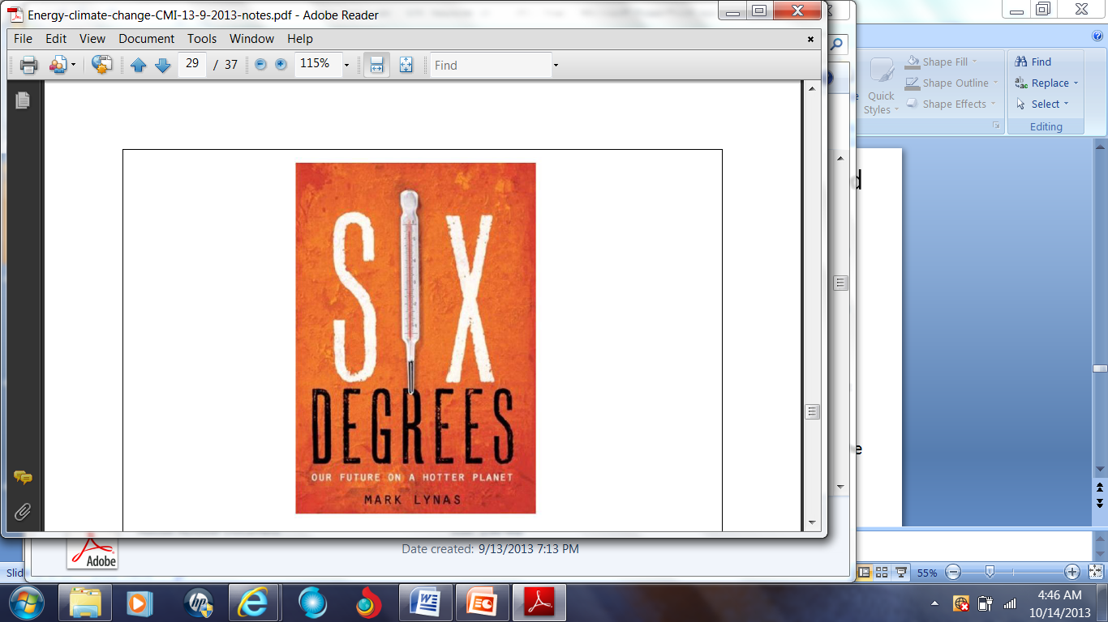

Slide 41
6 degrees world
What follows is an informal summary of the book for each degree of Celsius increase; the summary is just a quick and rough interpretation of some of the main messages of the book.
Note that we are now already heading for 4 and plus degrees Celsius world with business-as-usual trends.
Australian scientists just published a somewhat similar book about 4 Celsius degrees Australia,

Slide 42
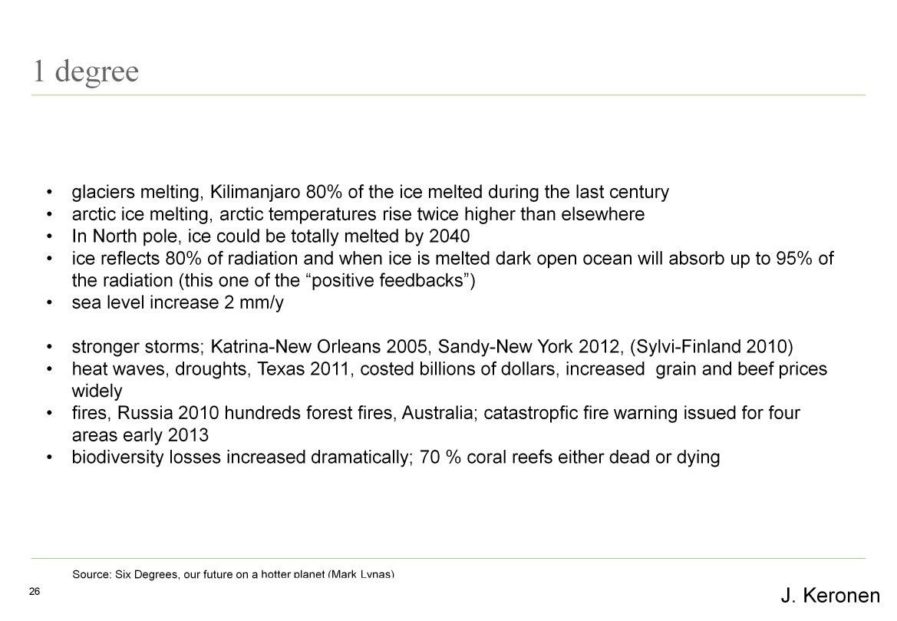

Slide 43
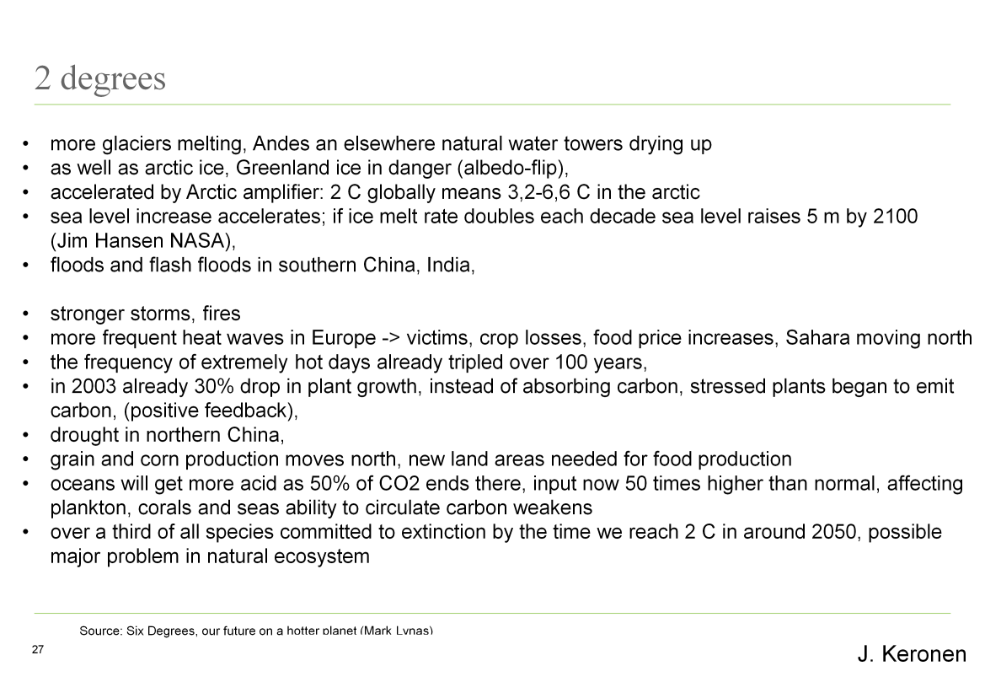

Slide 44
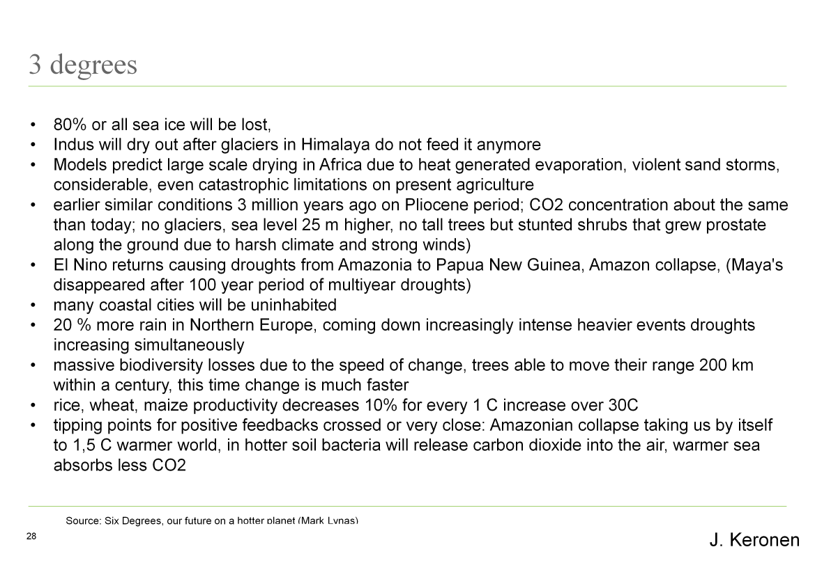

Slide 45
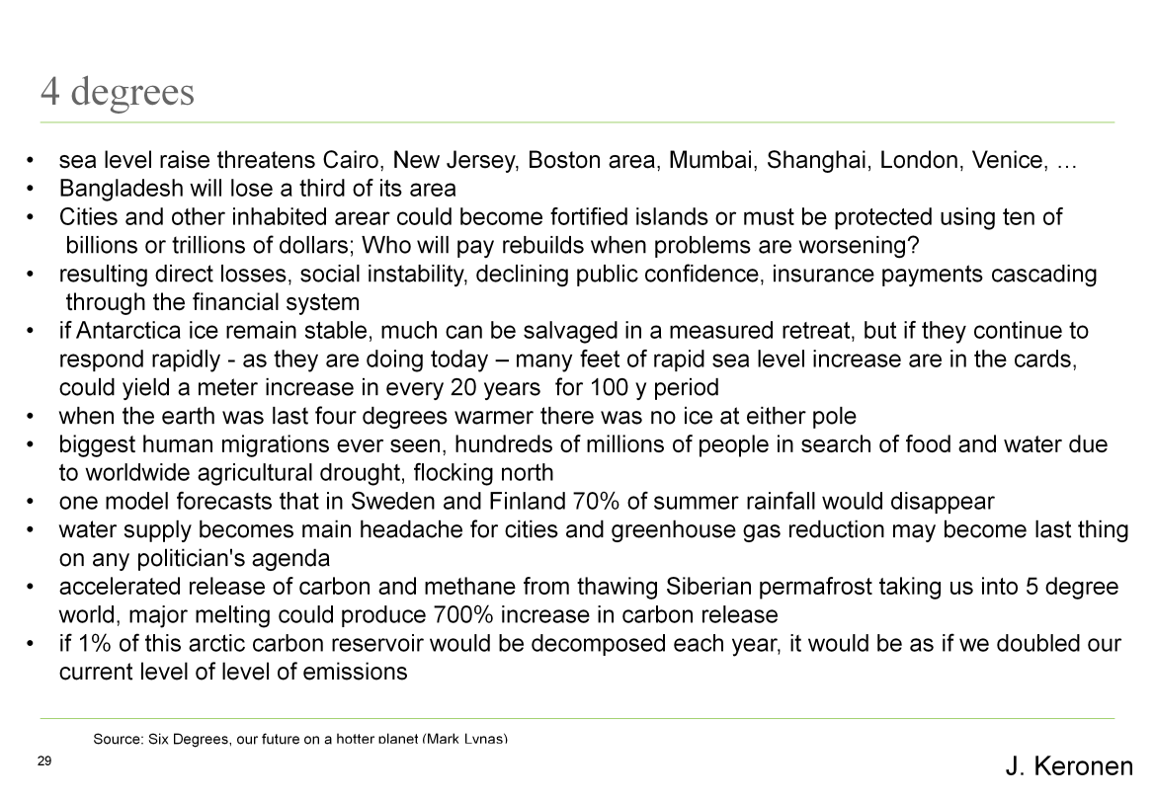

Slide 46
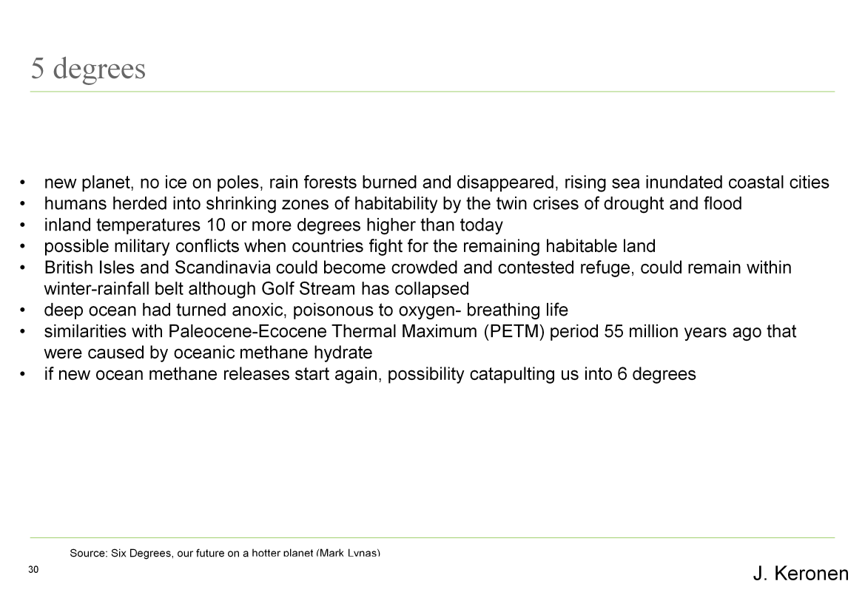

Slide 47
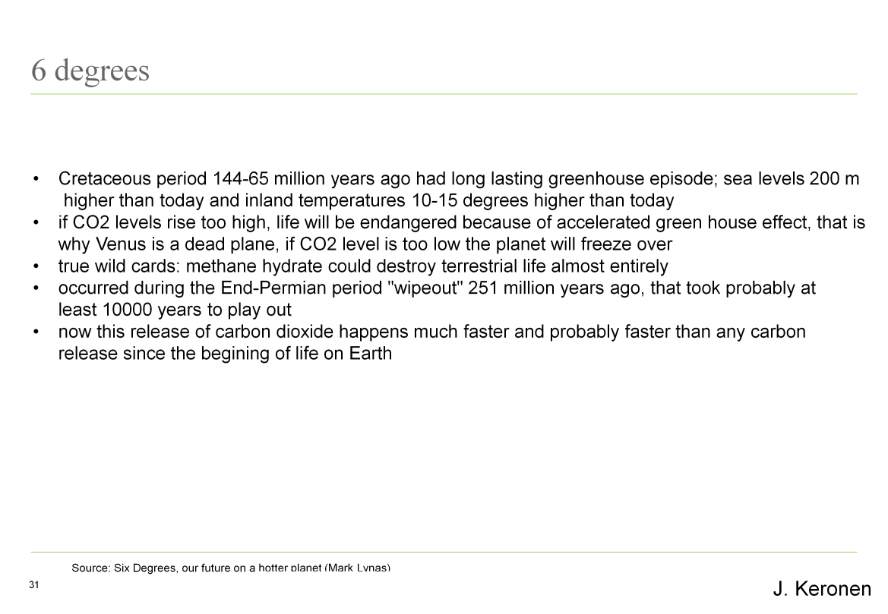

Slide 48
Modified SDGs based on a global emergency concept
New goals and targets should help us to make the transition from a business-as-usual world to a really sustainable future, in other words, to avoid horror scenarios presented in Lynas’ book above
Just three examples from High-level Panel’s goals:

Slide 49
Goal 1: end poverty
Accelerating climate change (floods, droughts, sea level rise) increase dramatically poverty in many developing countries as any available money goes to fight against disasters.
Therefore, goals and targets should concentrate on root causes of climate change, for instance, on fossil fuel subsidies by the Governments.
Fossil fuel subsidies should be phased out in xx years in developed countries; these subsidies should be redirected to renewables ; vulnerable developing countries should receive a major part of these subsidies.

Slide 50
Goal 8: Create jobs
Green economy and technology – not based on fossil fuels – is creating new jobs.
Targets should set for attaining a renewables-based global economy.
Job-creation targets would be attached to each phase in the process for each region and country.

Slide 51
Goal 9: Manage natural resource assets sustainably
UN System Task Team on Post-2015 Development Agenda referred in its July 2013 report to “Ecological Footprint” concept (p.32).
The UN should develop goals, targets and indicators in this area together with the Global Ecological Footprint network.
As discussed earlier regional variations are huge and goals and targets should take this into account and arrive at goals/targets/indicators to make the consumption of natural resources more equal between the regions.

Slide 52
Conclusions
I believe that the results in achieving SDGs and post-2015 development agenda as now conceived in UN documents will not be sustainable - in terms of our world between 2030-2100 - because of climate change, resource constraints and likely end of traditional economic growth as now commonly understood.
The UN and international community are wasting valuable time in focusing on short terms goals if they are not keeping in mind the world we likely have in 2030-2100.
Present SDGs and post-2015 work therefore needs reorientation and refocus.

Slide 53
Conclusions and recommendations
The UN reforms usually start when a group of concerned Ambassadors/diplomats get together and create a concept, vision and a non-paper
The interests of Ambassadors/diplomats/Governments of small island states and low-laying coastal states are different from others as climate change is for them a survival issue. But for others business-as-usual is an attractive option, unfortunately.
Representatives of small islands and coastal states could show leadership – together with scholars and NGOs!

Slide 54
Recommendation
Establish an informal group of interested and concerned diplomats, scholars and NGOs to create alternative initiatives, thinking, concepts, visions, goals, targets and indicators on global-emergency based SDGs within longer-term scenarios of the planet
Mainstream this new paradigm to the UN practice

Slide 55
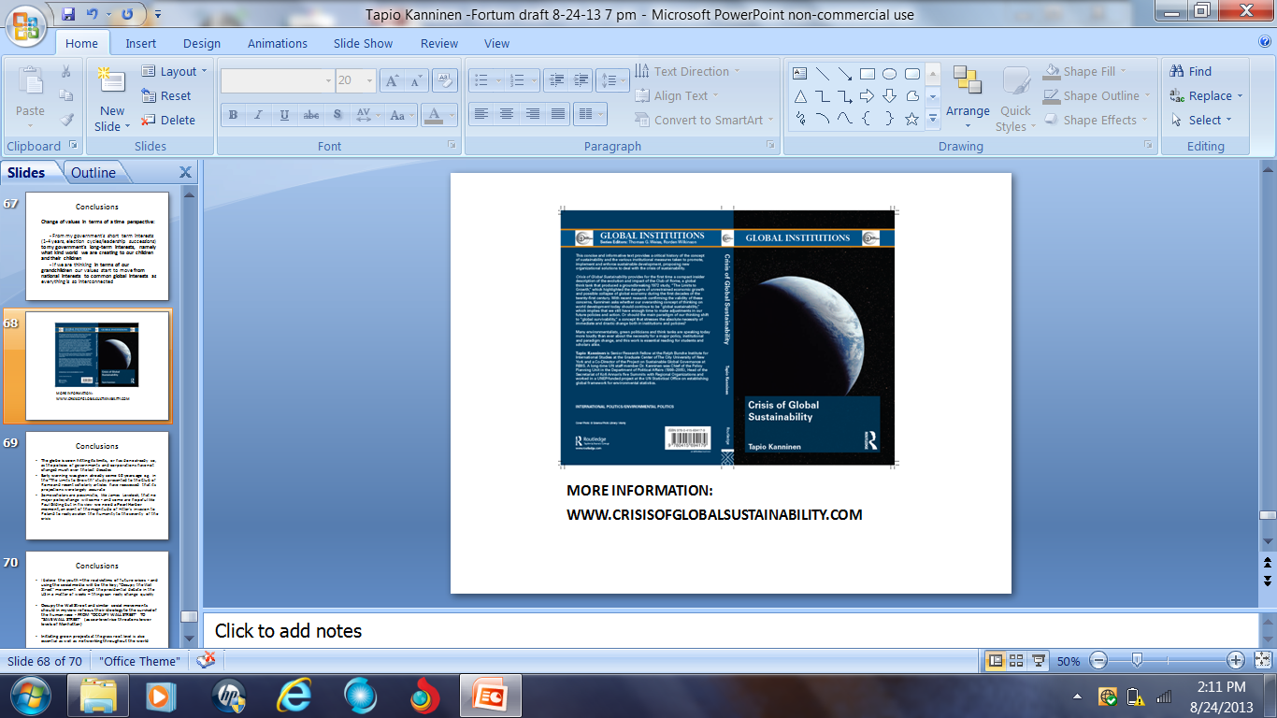
More information

