Slide 1
Crisis of Global Sustainability
Tapio Kanninen
Fortum Foundation’s Award Ceremony
Fortum Corporation
Espoo, Finland
27 August 2013

Slide 2
Outline
Global environment and trends
The history of global awareness on global threats: The Limits to Growth –study and the Club of Rome
What has been accomplished in international negotiations?
How can we turn the world development to a sustainable path?
5. Conclusions

Slide 3
Four very big problems of humankind
1. Global climate change
2. Global problems in energy and resources
3. Interconnectedness between climate change and global energy use
4. Meta-problem: what we do now will determine the global development path for decades and centuries to go
Note: Access to water, global food crisis and world financial crises are all connected to the above problems

Slide 4
BIG PROBLEM 1:Global climate change
The warming of the planet has continued globally as well as in Finland

Slide 5
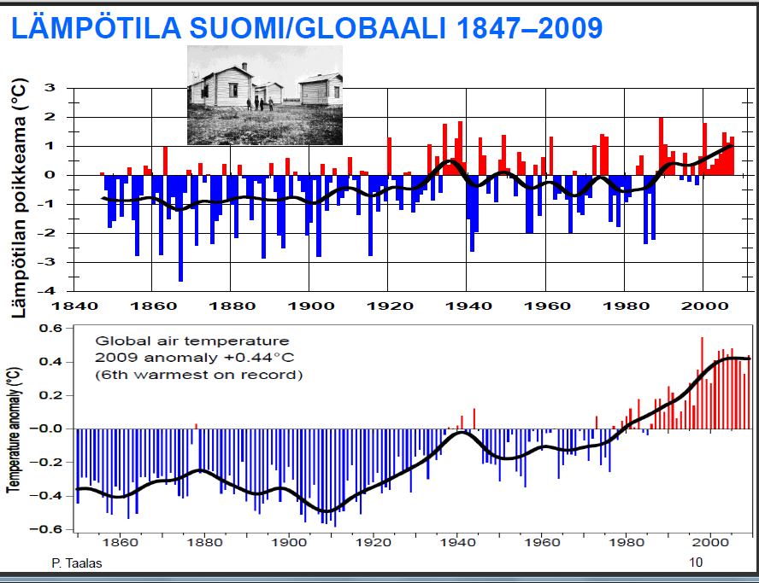

Slide 6
BIG PROBLEM 1:Global climate change
Global CO2 and other green house emissions have continued without interruption

Slide 7
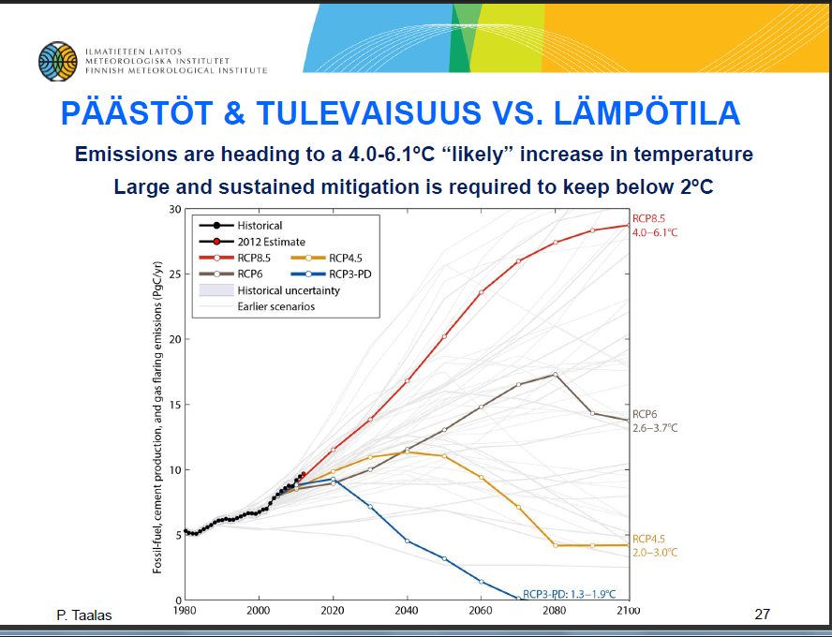

Slide 8
BIG PROBLEM 1:Global climate change
The role of China and India (and other BRICS-countries) has continued to grow, and will grow in the future even more rapidly, in global emissions

Slide 9
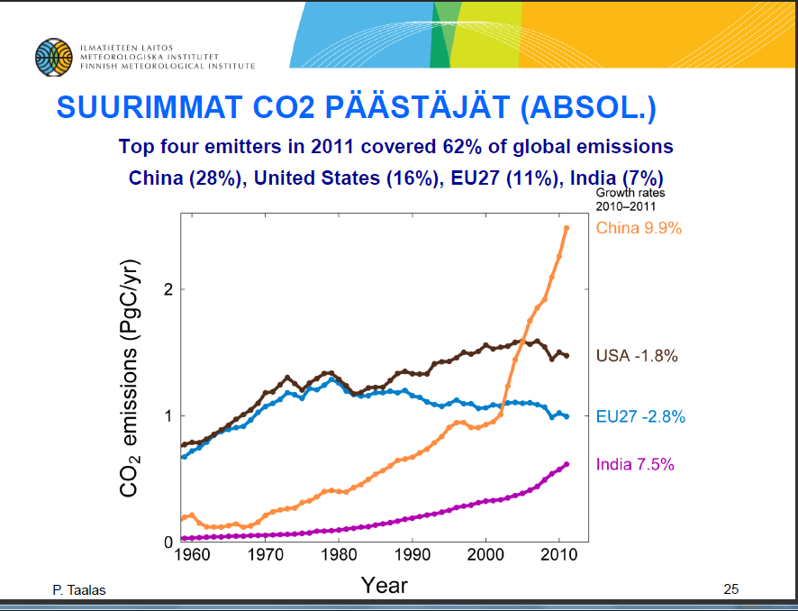

Slide 10
BIGPROBLEM 1:Global climate change
Subproblem 1.1:
Arctic and Antarctica are warming more rapidly than other parts of the world
This trend will intensify the rise of sea-level in the near future

Slide 11
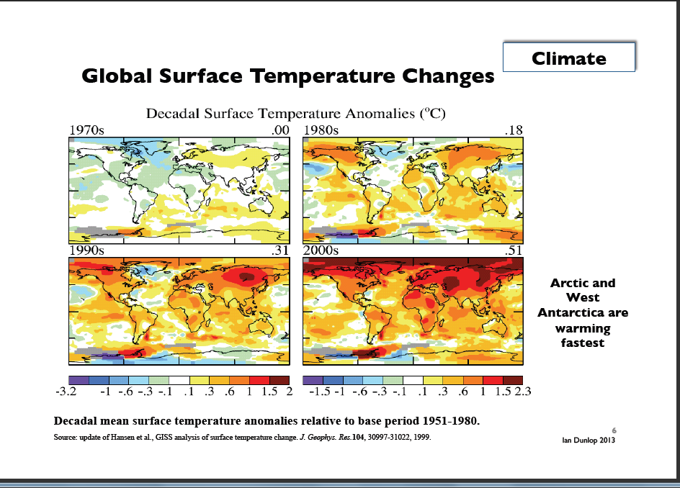

Slide 12
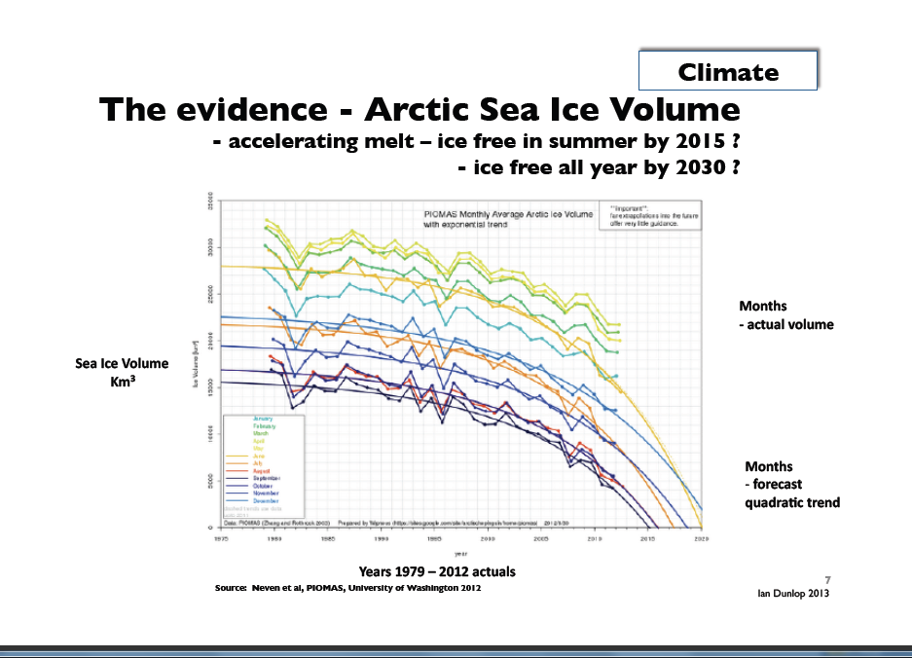

Slide 13
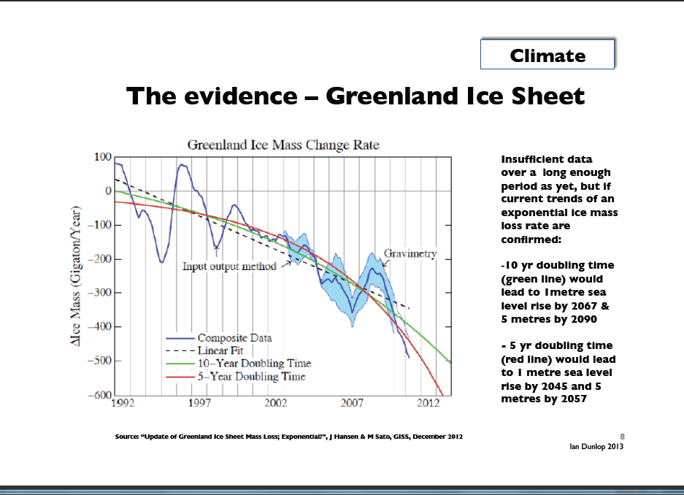

Slide 14
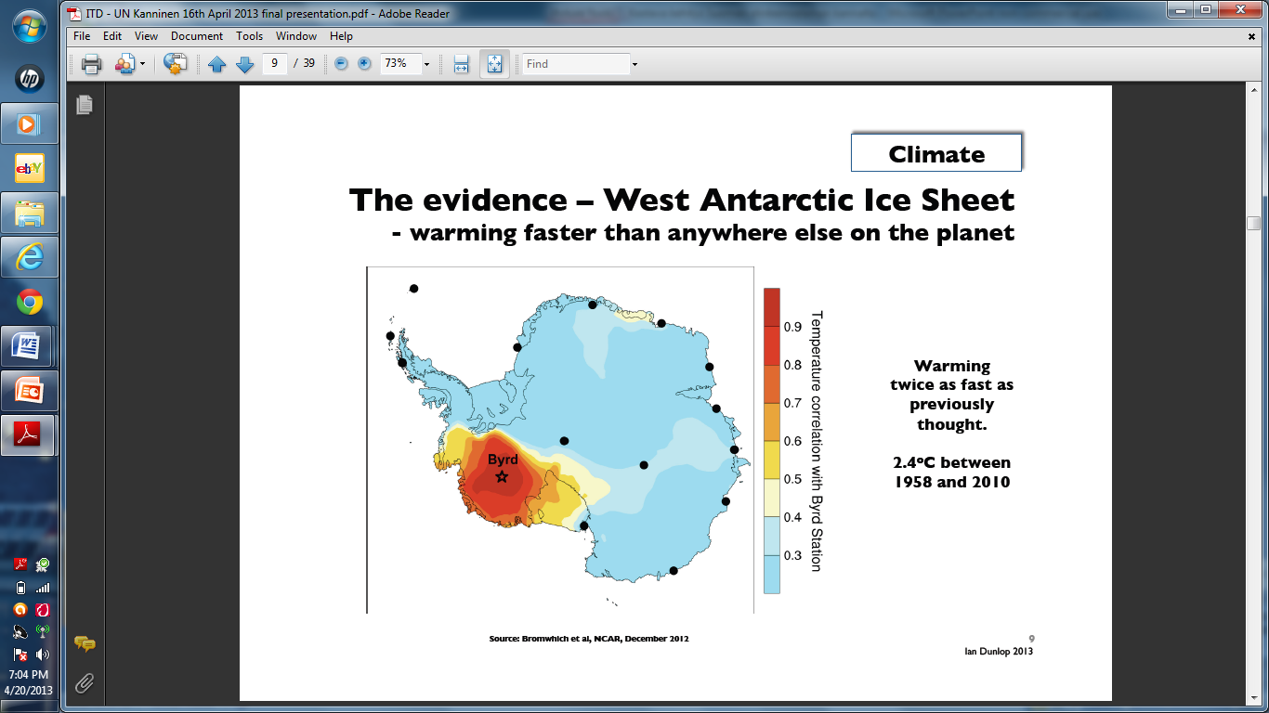

Slide 15
BIG PROBLEM 1:Global climate change
Subproblem 1.2: Tipping Points
Tipping points are irreversible mechanisms that might trigger self-reinforcing catastrophic climate change – some say in a matter of years rather than decades
Scientists have determined some 15 candidates for tipping points

Slide 16
BIG PROBLEM 1:Global climate change
Climate change’s impact on the rise of sea level.
Two schools of thought among climate scientists:
SCHOOL OF THOUGHT 1: Cautious scientists who stress the lack of data and difficulties in methods – sea level would rise ½ - 1 meters in 100 years (IPCC reports)
SCHOOL OF THOUGHT 2: Bolder scientists who do not deny the lack of data and difficulties in methods but try to estimate the impact of tipping points for our decision-making – sea level rise would rise some 5-7 meters in 100 years

Slide 17
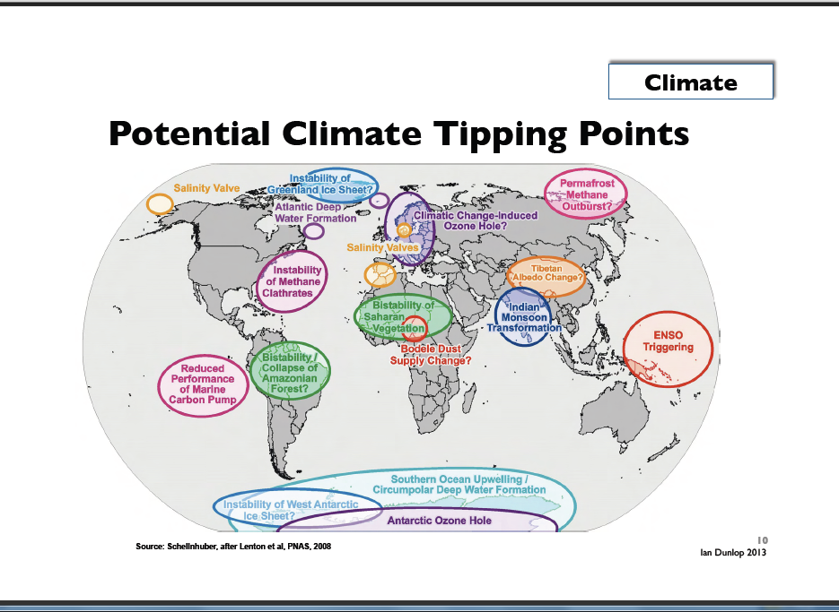

Slide 18
BIG PROBLEM 1:Global climate change
Dr. James Hansen, long-term head of NASA’s Goddard Institute for Space Studies and a leading climate scientist at Columbia University’s Earth Institute
Uses paleoclimate evidendence

Slide 19
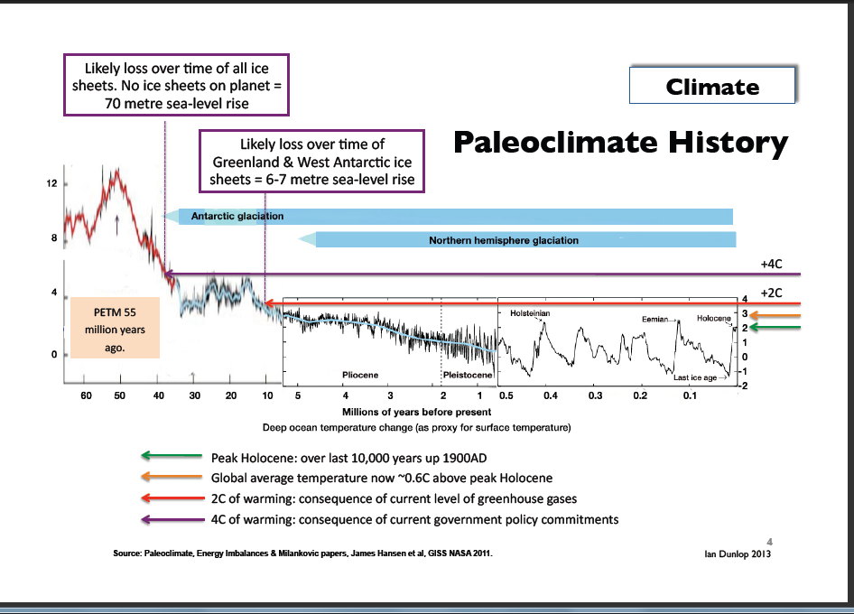

Slide 20
BIG PROBLEM 1:Global climate change
Most scientists in both schools of thought think that the present international climate change target – to limit the temperature increase to 2°C compared to average temperature in pre-industrial times – is determined by political considerations and not by science
The right target should be 1,5 degree whereas we are now going to 4 °C + world
Second school’s representatives tell where we are heading to:

Slide 21
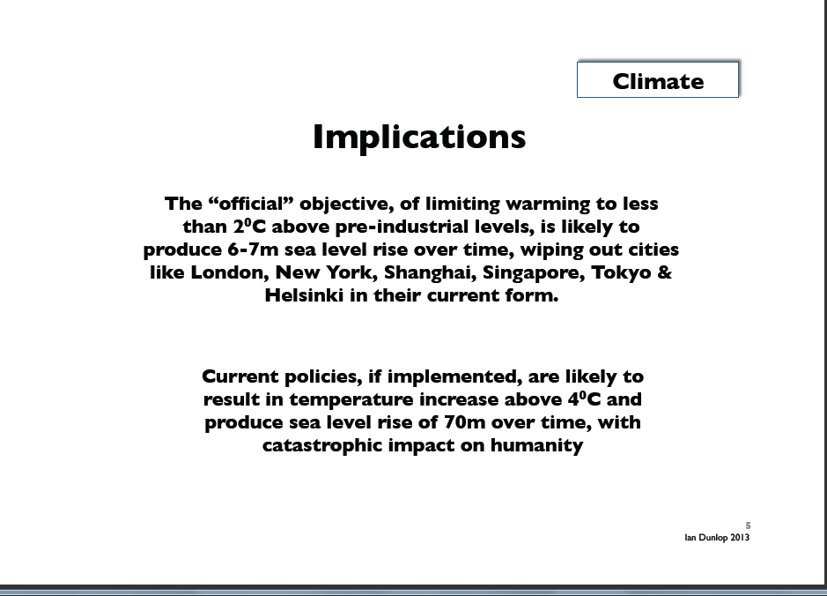

Slide 22
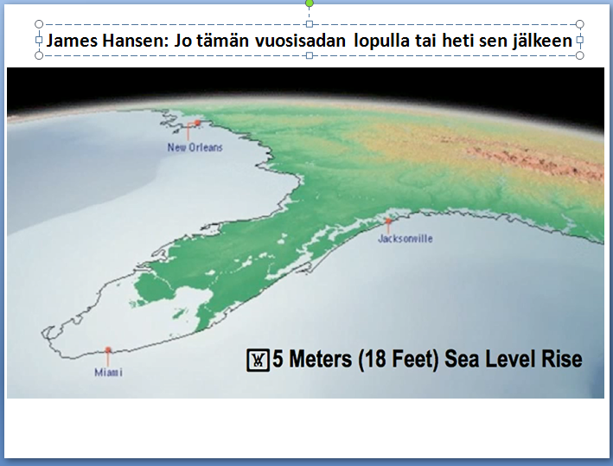

Slide 23
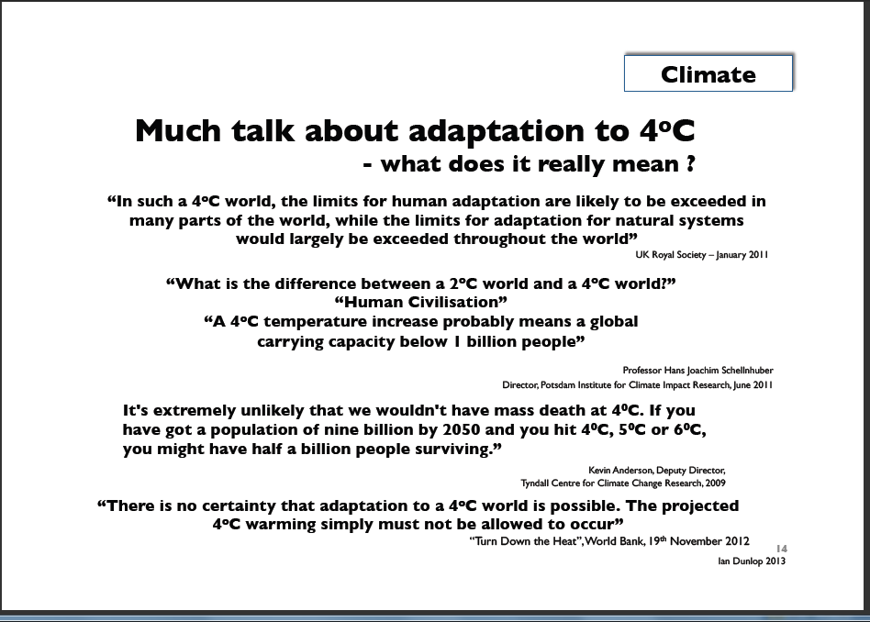

Slide 24
BIG PROBLEM 1:Global climate change
As further evidence that climate is changing rapidly we have an increasing rate of natural catastrophes linked to climate and well as the loss of biodiversity

Slide 25
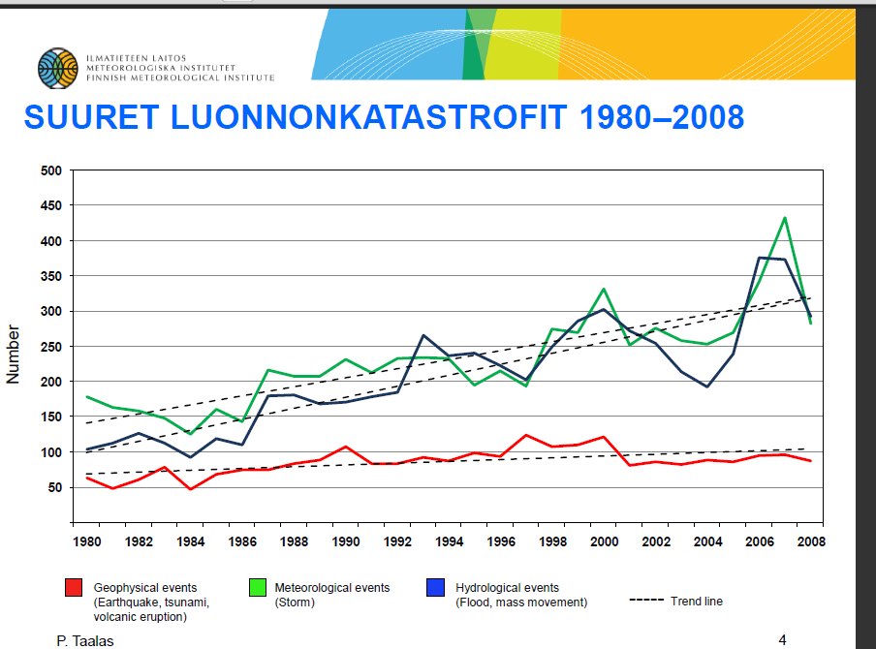

Slide 26
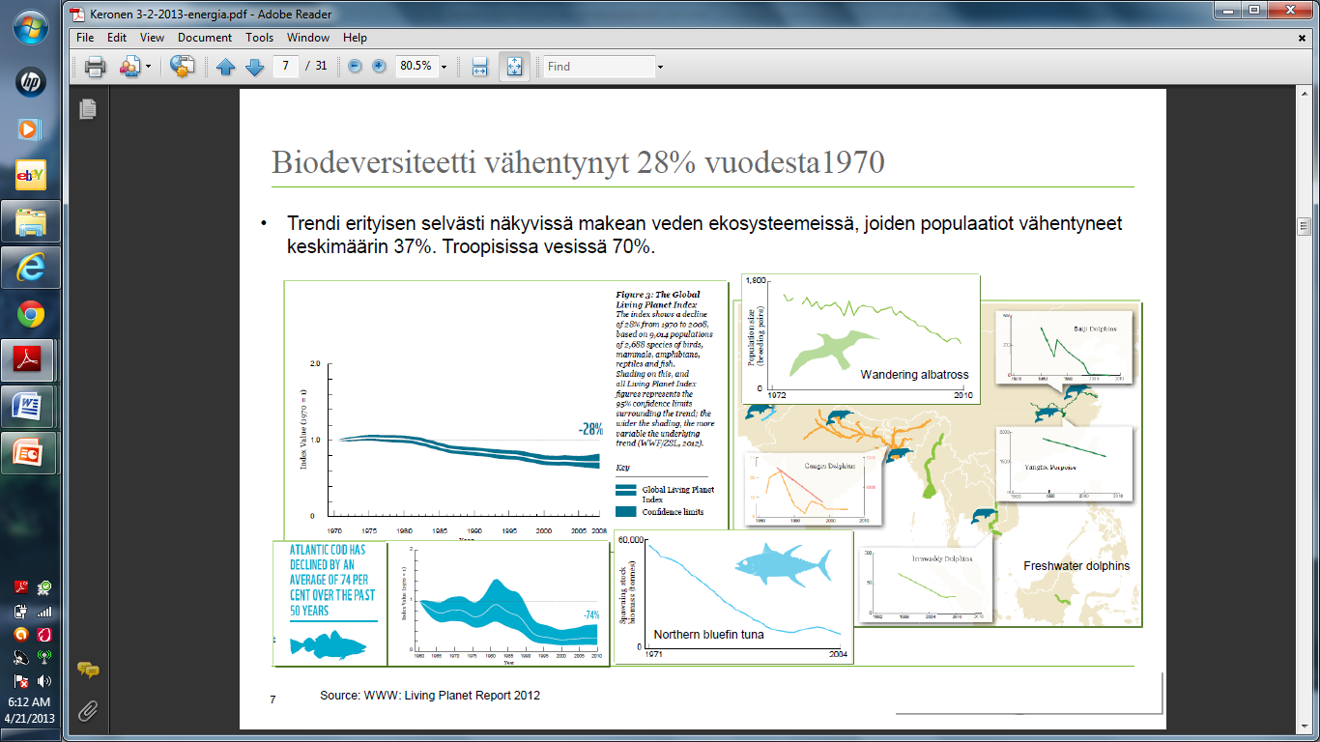

Slide 27
BIG PROBLEM 2: Our resources
Our global wellbeing and economic growth have been measure by national accounts which use Gross National Product (GDP) as a key measurement of growth, but GDP does not tell about the impact of growth on environment
In the future, so called “global ecological footprint” will be in key position
It will ultimately answer the question whether our economic development is based on a Ponzi-scheme in terms of its use of global resources

Slide 28
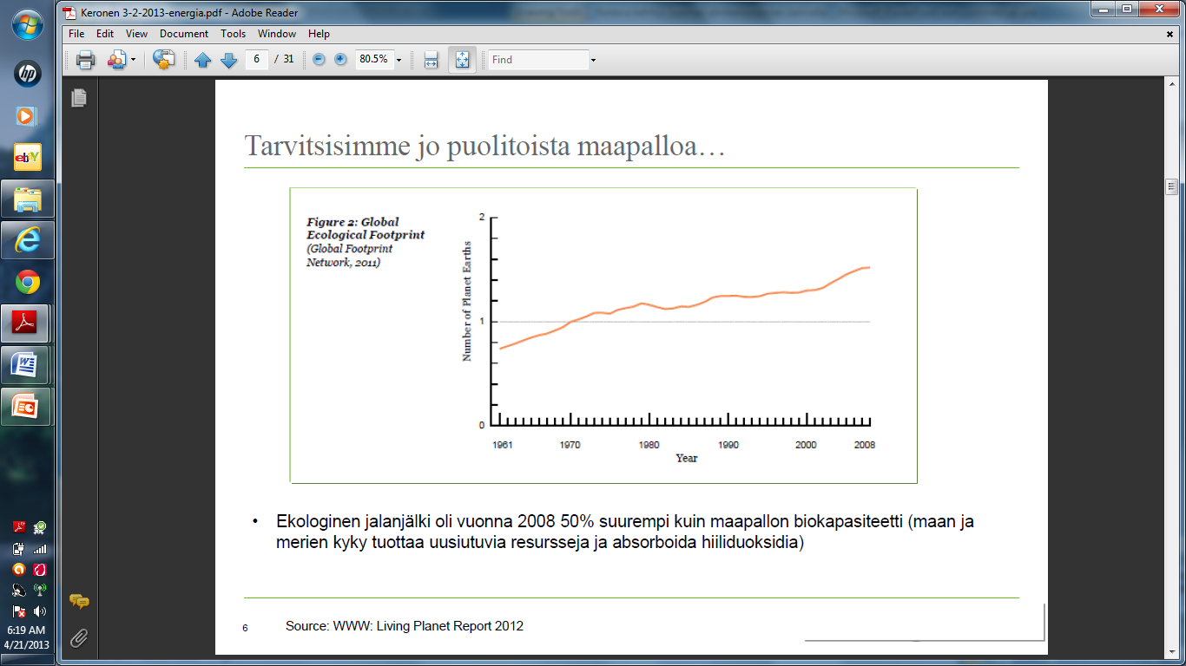

Slide 29
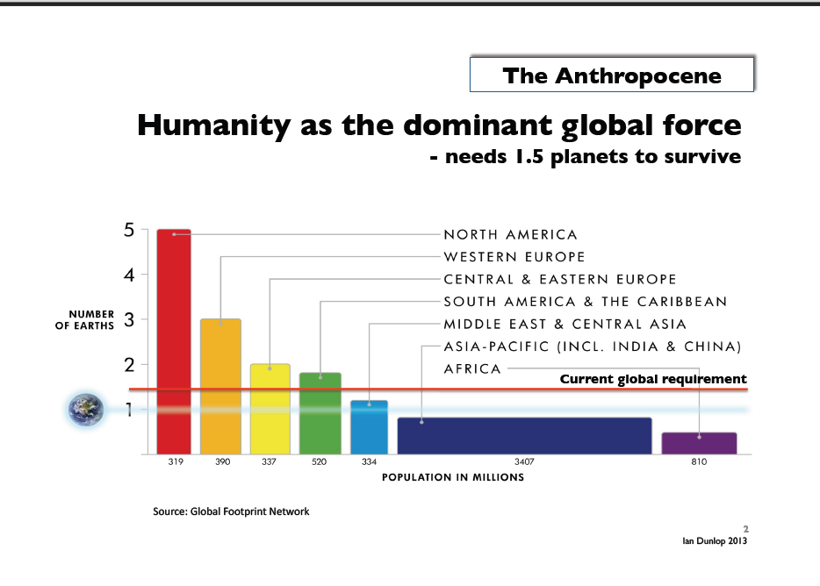

Slide 30
BIG PROBLEM 3: Global energy use
Subproblem 3.1: The dropping cost/benefit ratio for oil industry
Cost/benefit ratio of oil industry (energy return on energy invested, ERoEI) has dropped during the last decades
To pump oil to the ground needs also energy. Whereas one barrel of oil could produce still in the 1920’s and 1930’s some 100 barrels of oil for consumption, one barrel could only produce some 50 barrels in 1970 and only some 20 barrels this year.
The cost/benefit ratio of gas, coal and renewable energies are clearly lower than oil
Our economic growth has so far based on cheap energy but the era of cheap energy is over!

Slide 31
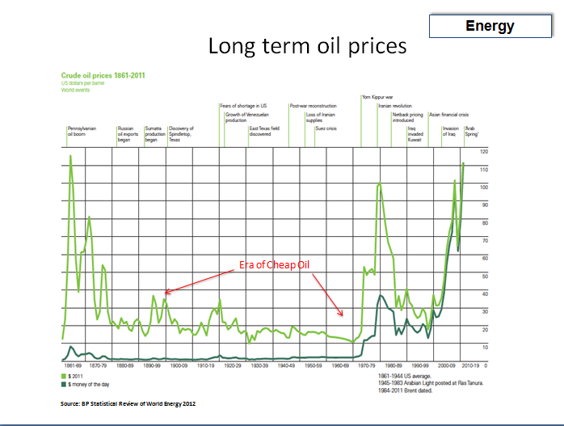

Slide 32
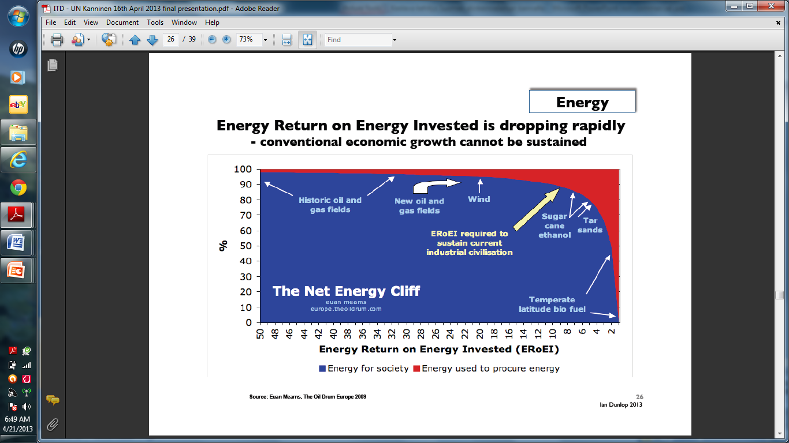

Slide 33
BIG PROBLEM 3: Global energy use
Sub-problem 3.2: Peak oil

Slide 34
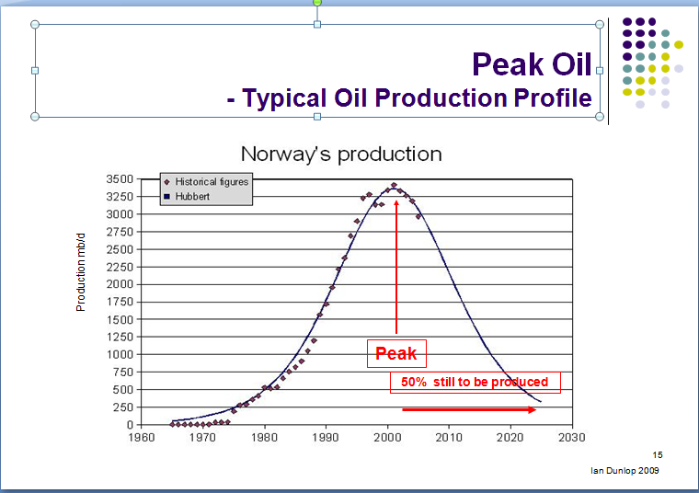

Slide 35
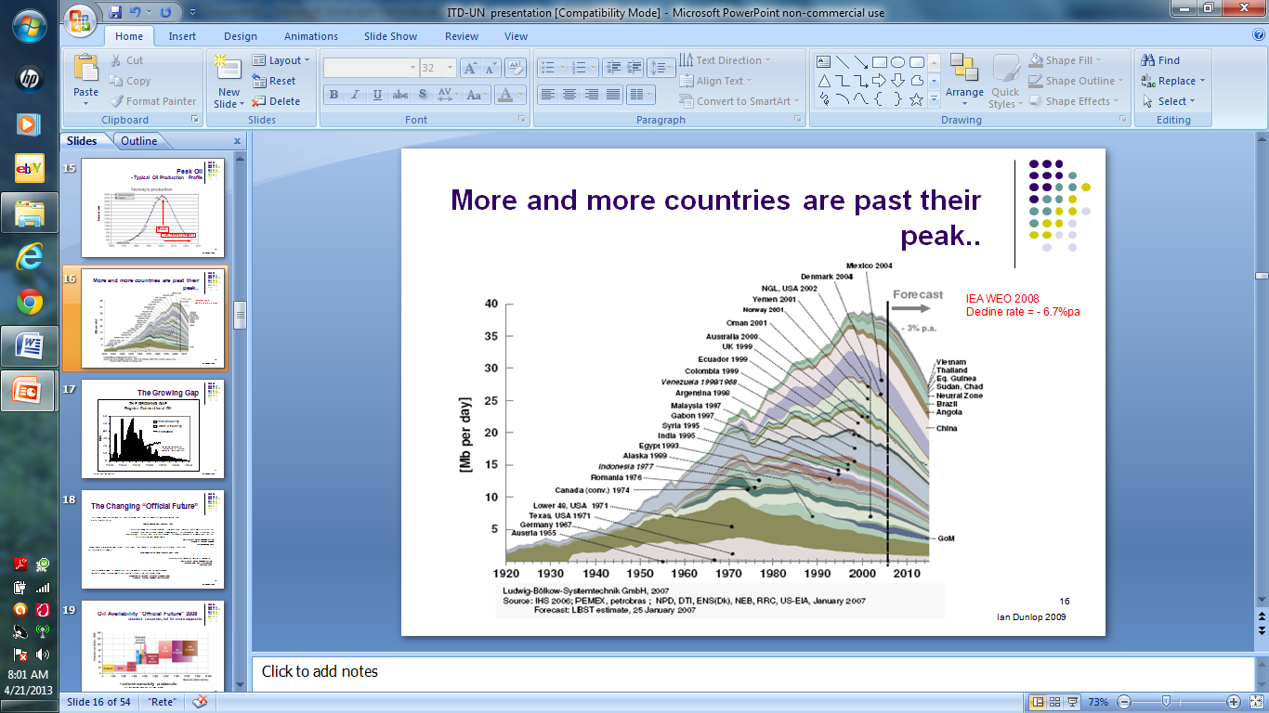

Slide 36
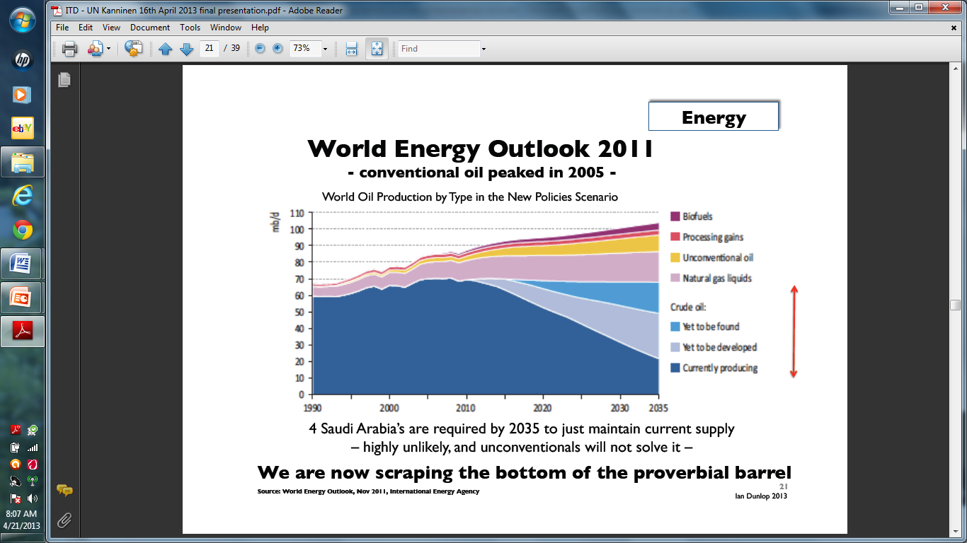

Slide 37
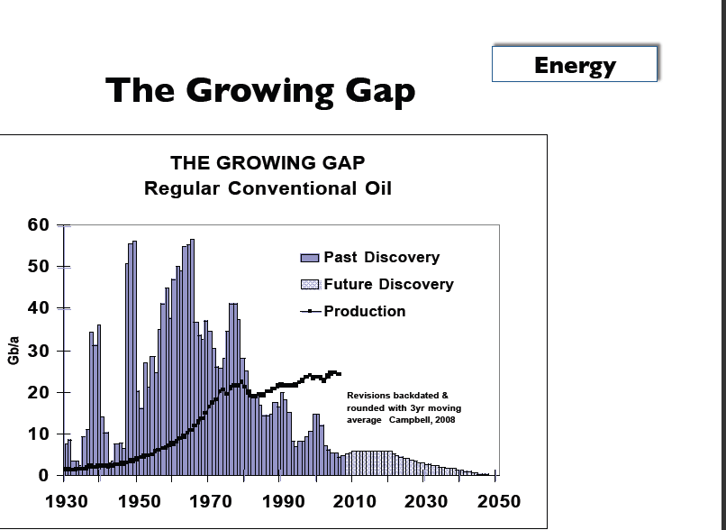

Slide 38
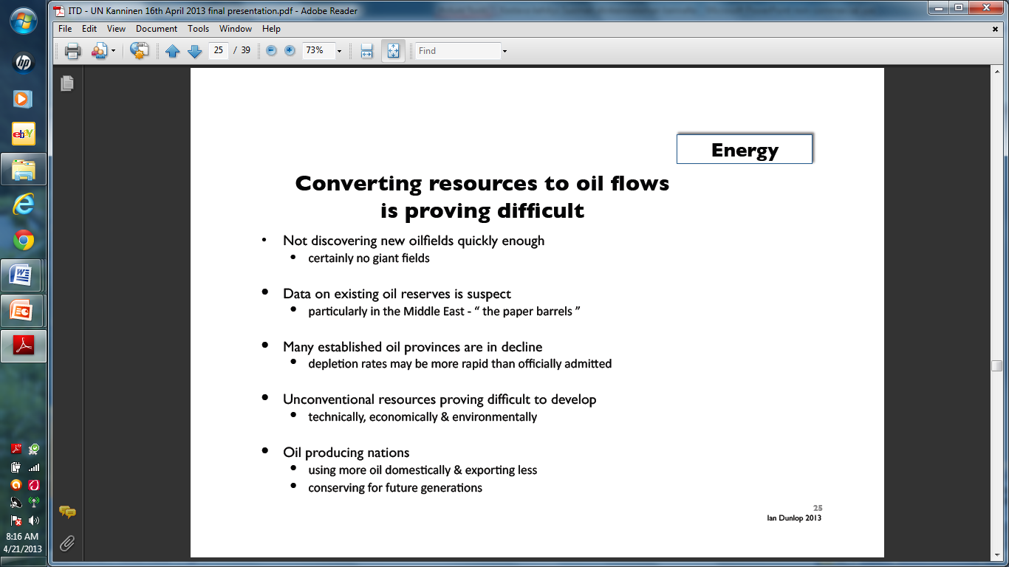

Slide 39
BIG PROBLEM 3. Interconnectedness between climate change and global energy use
How could we attain 2° C official target in climate change talks and continue our current economic growth and energy use as before?
Ian Dunlop’s theses; Dunlop was Shell’s engineer and senior executive over 30 years as well as the main developer of the carbon emission trading system in Australia

Slide 40
Connections between global economic growth , energy use and climate change
QUESTION NO.1:
Can global economic growth continue whilst simultaneously limiting global temperature increase to 2°C? According to Dunlop the answer is clearly no (albeit the non-availability of cheap energy sources may well itself slow growth quite separately from efforts to limit global warming). We are not running out of either oil, coal, or gas resources—the issue is how to convert these resources into flows to the market in an environmentally and economically acceptable manner or to move to alternative energy sources. Only 30-40 percent of current proven fossil-fuel reserves can be burnt to have a reasonable chance of remaining below the 2°C target.

Slide 41
Connections between global economic growth, energy use and climate change
QUESTION NO. 2:
Can technology help us move quickly to make the use of fossil fuels less polluting so that our economic growth model can continue? The answer is also a clear no. All present technologies to make such a transition would be too expensive, environmentally damaging, and time-consuming.

Slide 42
Connections between global economic growth, energy use and climate change
QUESTION NO. 3:
Can our global economic growth model continue if we quickly move to the alternative energy sources of renewables and nuclear? Here also the answer is a clear no, according to Dunlop, as the present alternatives—primarily solar, wind, and nuclear—contribute only a small proportion of global energy supplies relative to fossil fuels. Thus their replacement of fossil fuels while maintaining global economic growth is highly unlikely in the short term, though it may provide a longer term solution for a steady-state economy.

Slide 43
BIG PROBLEM 4: what we do now will determine the global development path for decades and centuries
The question of urgency

Slide 44
Allison Macfarlane, chair of BAS’ Science and Security Board :
After the Doomsday Clock was moved in January 2012 back one minute, now 5 minutes to midnight – from nuclear holocaust to environmental holocaust:
“The global community may be near a point of no return in efforts to prevent catastrophe from changes in Earth’s atmosphere. The International Energy Agency projects that, unless societies begin building alternatives to carbon-emitting energy technologies over the next five years, the world is doomed to a warmer climate, harsher weather, droughts, famine, water scarcity, rising sea levels, loss of island nations, and increasing ocean acidification.”
“Since fossil-fuel burning power plants and infrastructure built in 2012-2020 will produce energy—and emissions—for 40 to 50 years, the actions taken in the next few years will set us on a path that will be impossible to redirect. Even if policy leaders decide in the future to reduce reliance on carbon-emitting technologies, it will be too late.”

Slide 45
EU/Council of Europe: climate change targets
In order to reach 2°C climate change target:
EU: CO2 reduction by 2050 80% compared to the level of 2005
Council of Europe: reduction of green house emissions by 2050 80-95% compared to 2005 level
REALISM CHECK: Exxon expects the developed countries to reduce only 20% CO2 emissions and developing countries increasing emissions by 50% by 2040

Slide 46
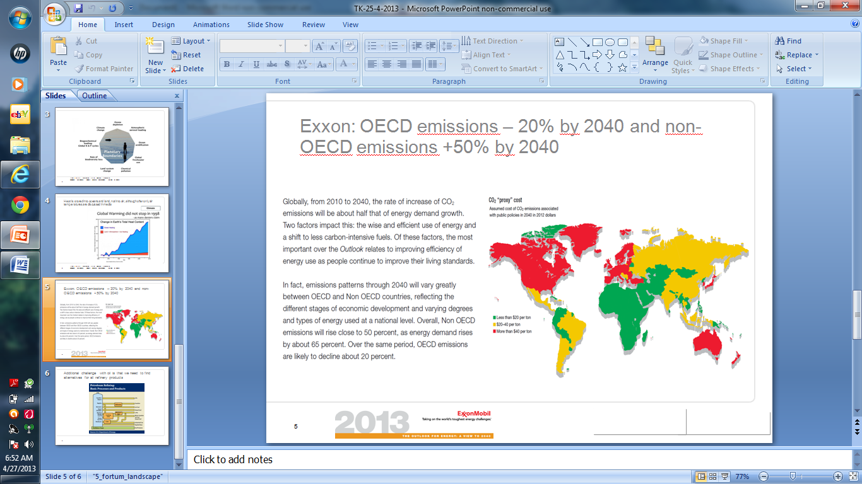

Slide 47
BIG PROBLEM 5:
Inefficiency of global negotiations on climate change and sustainable development

Slide 48
History of our awareness on global threats – before international negotiations started
Awareness started in the 1960s
One major awareness raiser was the Club of Rome

Slide 49
Club of Rome and its “The Limits to Growth” (LtG) Study
established in 1968 but still active (over 30 chapters and still growing)
contributed a lot to the concept of the World Economic Forum in Davos but stopped itself being an organizer of big meetings between politicians, scholars and NGOs
- concentrated recently more on studies but now its modus operandi is under revision - communicating the emergency of the globe to the different audiences in most effective ways possible

Slide 50
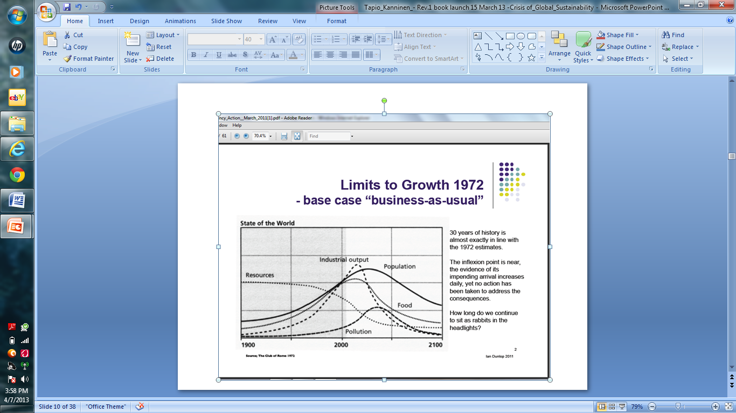

Slide 51
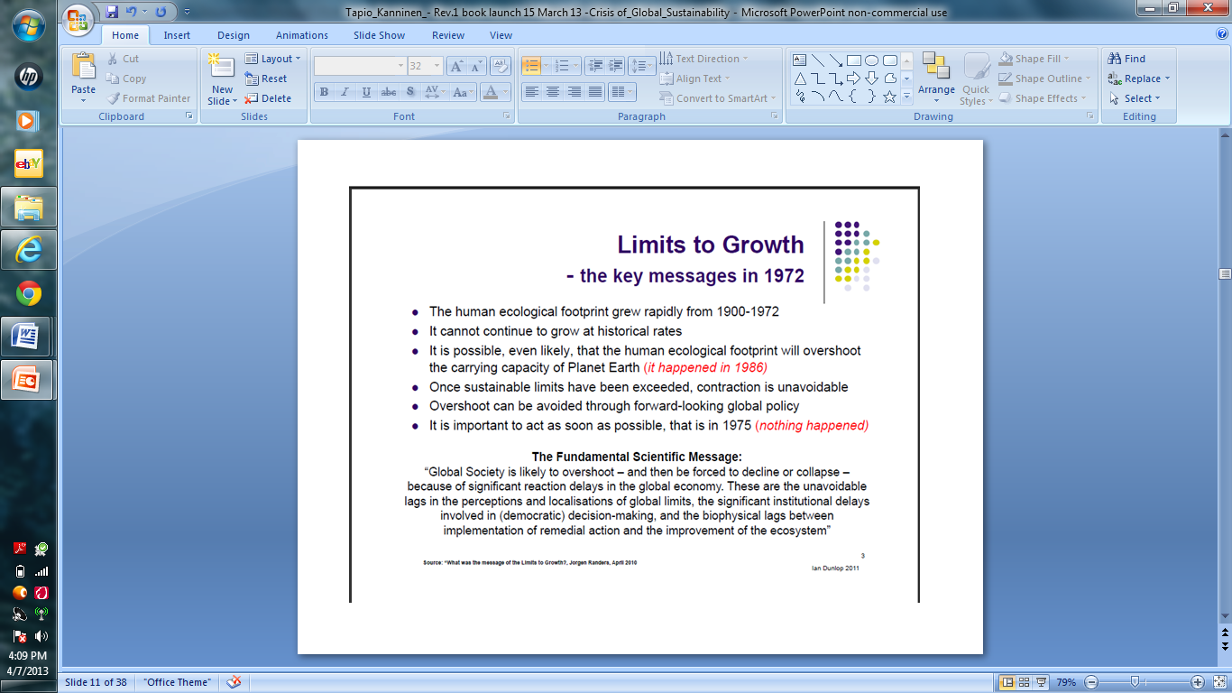

Slide 52
Graham Turner
Senior Scientist, CSIRO/Australia
…the observed historical data for 1970-2000 most closely matches the simulated results of the LtG "standard run" scenario for almost all the outputs reported; this scenario results in global collapse before the middle of this century. The comparison is well within uncertainty bounds of nearly all the data in terms of both magnitude and the trends over time. Given the complexity of numerous feedbacks between sectors incorporated in the LTG World3 model, it is instructive that the historical data compares so favorably with the model output [2008 study]

Slide 53
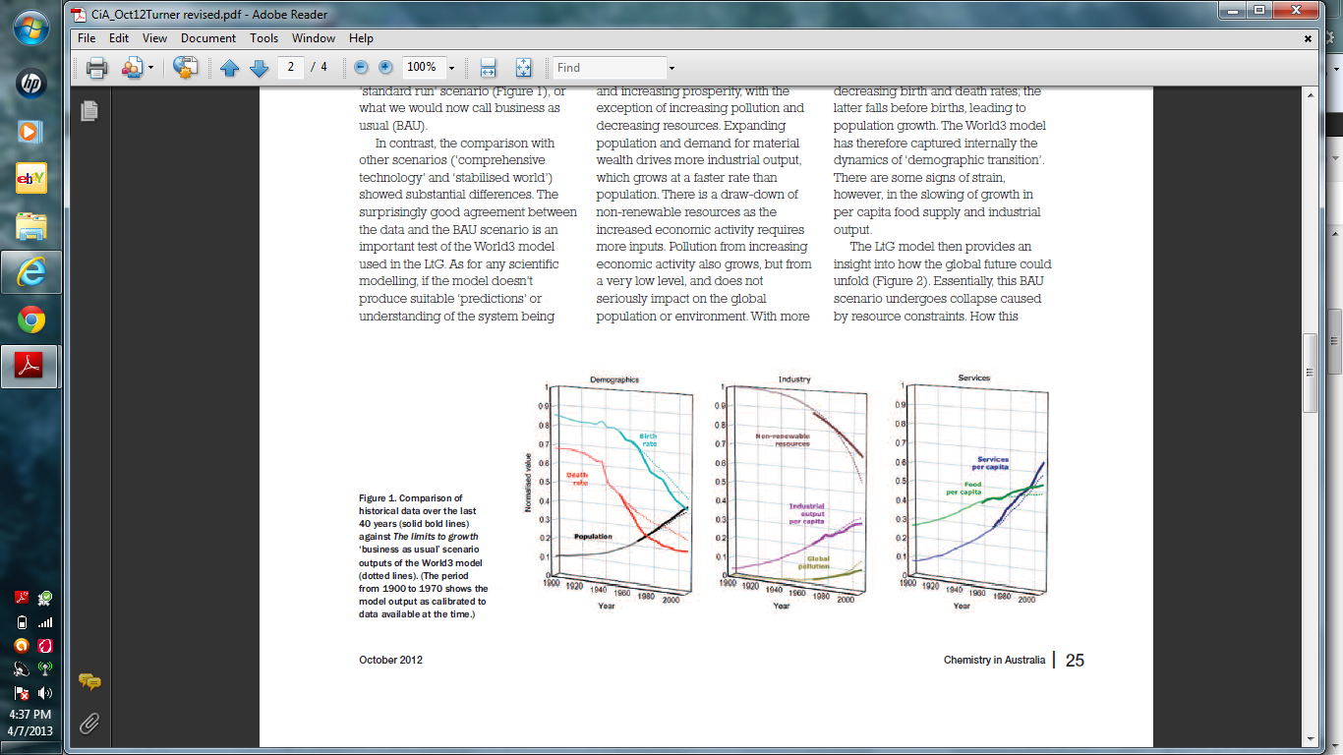
Graham Turner
Senior Scientist, CSIRO/Australia

Slide 54
Charles A.S. Hall and John W. Day
May-June 2009 issue of American Scientist: "the model results are almost exactly on course some 35 years later in 2008…it is important to recognize that its predictions have not been invalidated and in fact seem quite on target. We are not aware of any model made by economists that is as accurate over such a long time.”

Slide 55
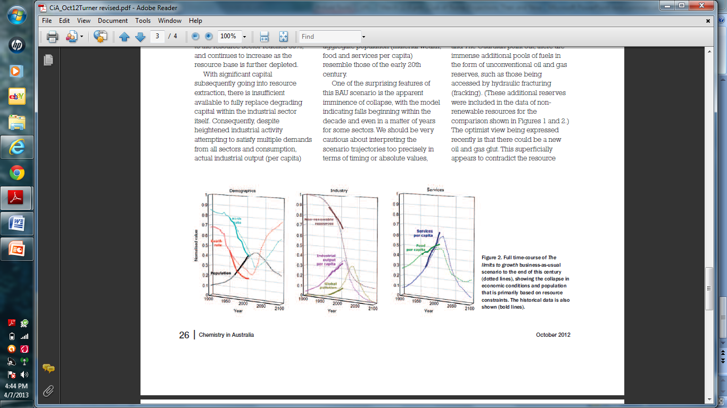
Graham Turner
Future

Slide 56
Dennis Meadows
Team Leader of LtG Authors
“Global warming is not discussed or analyzed in LtG. That is correct. But to conclude from that that it is "a separate threat to mankind" is incorrect. Global warming is precisely the sort of feedback we were speaking about—it is one of the factors that will cause growth to stop. But even if the greenhouse effect did not exist, growth will still stop. Oil depletion, soil erosion, aquifer depletion, and scarcity of critical non-renewable materials each have the capacity to stop growth. None of them is "separate.“ [Dec 2011]

Slide 57
Have international negotiations changed the ominous global trends LtG warned about?
- the bottom line approach: has the humanity been able to change the most dangerous trends threatening the well-being and even existence of human race
- make it simple, bottom line concept: monitor only key indicators absolutely critical for humanity in the decades and centuries to come: one such indicator certainly "global CO2 emissions"

Slide 58
Have international negotiations changed the ominous global trends LtG warned about?
A review in terms of bottom line indicators:
Environment/Sustainable Development Conferences - Stockholm 1972, Rio 1992, Johannesburg 2002, Rio+20 in 2012
Climate Change negotiations Kyoto 1997, Copenhagen 2009, Cancun 2010, Durban 2011, Doha 2012
“Crisis of Global Sustainability” book (Routledge 2013): NO – we are not on a sustainable path but in a global emergency! The UN negotiation system does not work!

Slide 59
Solutions to our global dilemma
Alternatives:
a) Continue intergovernmental negotiations as before
-difficult to make the impact on the bottom line indicators as so many participants and groupings involved and very diversified national/group interests
- danger that the compounded, synergistic impact of crossing the tipping points will kick in soon and we face a unstoppable, runaway climate change

Slide 60
Solutions to our global dilemma
b) improve negotiation approaches (forums, settings, groupings involved and techniques applied)
- some NGOs, scholars and practitioners have made suggestions to this effect
- in improving the forums and techniques: keep in mind the bottom line indicators for the globe; away from national or group interests to common interests

Slide 61
Solutions to our global dilemma
c) most powerful will decide on a global scale (G-20, G-8, BRICS, OECD countries etc)
- promoted by Jorgen Randers – Paul Gilding - creating a global command-type war economy (with a task of the magnitude WW I and II combined)
- undemocratic and might not be effective

Slide 62
Solutions to our global dilemma
d) concentrate on drastic action at country level, on bilateral relations and/or at the level of small or large groupings of states - unilateral voluntary action
- could be effective at times but we need also an agreed global framework and regulatory, enforcement systems to implement it (e.g. price of carbon emissions, global taxes etc) so that we could also use market-based approaches to cut down emissions most effectively and on an urgent basis

Slide 63
Solutions to our global dilemma
e) If the runaway climate change kicks in (too late to prevent a major catastrophe and say 5-70 meters sea level rise):
- revise urgently the UN Charter (start a Charter review conference Article 109 as a basis) to overhaul it completely for rapidly changing global and regional conditions
- as an interim measure establish interlinked crisis centers around the globe

Slide 64
Solutions to our global dilemma
e) If the runaway climate change kicks in (cont)
- establish a global crisis center – a model for this in International Peace Institute (IPI) in New York but enlarge its scope to deal with environmental and socio-economic/financial issues and their interrelations
- establish regional crisis centers – a model is International Crisis Group (ICG) but expand as above
- establish national sustainability centers – a model is Helsinki Sustainability Center (Chair of the Board Pres. Tarja Halonen)
- establish local sustainability centers

Slide 65
Conclusions
f) Change the concept for success in global negotiations on climate change and sustainable development:
- now success is mostly seen as keeping the system from collapsing (facing a credibility gap) and achieving small steps, mostly in organizational design
- a future benchmark should be how the negotiations affect the bottom line indicators - immediately and in reality

Slide 66
Conclusions
g) Change of values in terms of a time perspective:
- From my government's short term interests (1-4 years, election cycles/leadership successions) to my government's long-term interests, namely what kind world we are creating to our children and their children
- If we are thinking in terms of our grandchildren our values start to move from national interests to common global interests as everything is so interconnected

Slide 67
Conclusions: final thoughts
The globe is soon hitting its limits, or has done already so, as the policies of governments and corporations have not changed much over the last decades
Early warning was given already some 40 years ago e.g. in the “The Limits to Growth” study presented to the Club of Rome and recent scholarly articles have reassessed that its projections were largely accurate
Some scholars are pessimistic, like James Lovelock, that no major policy change will come - and some are hopeful like Paul Gilding but in his view we need a Pearl Harbor moment, an event of the magnitude of Hitler's invasion to Poland to really awaken the humanity to the severity of the crisis

Slide 68
Conclusions
I believe the youth – the real victims of future crises - and using the social media will be the key ; “Occupy Wall Street” movement changed the presidential debate in the US in a matter of weeks even if the new agenda did not last very long – things can really change quickly
Occupy Wall Street and similar social movements should in my view refocus their ideology to the survival of the human race - FROM “OCCUPY WALL STREET” TO “SAVE WALL STREET” (as sea-level rise threatens lower levels of Manhattan as hurricane Sandy demonstrated)
Initiating green projects at the grass root level is also essential as well as networking throughout the world

Slide 69
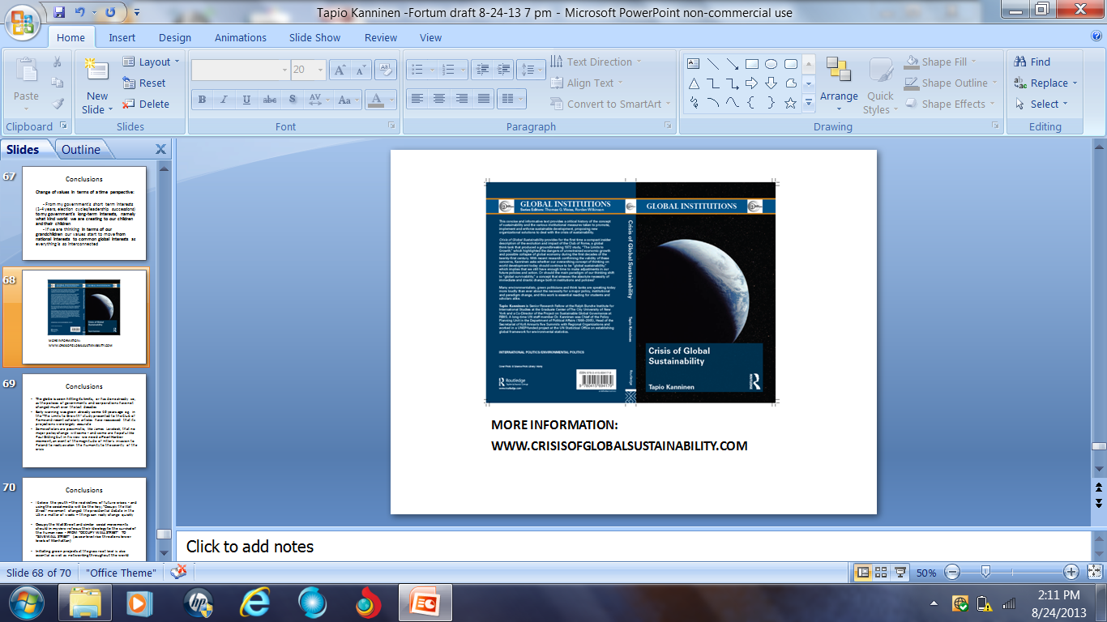
More information

